Slide 1
Moving Digital Transformation Forward
Professor Steve Burdon
Leeds Business School Conference
Strategic Response to Disruptive Technology
Royal Society of Arts - London
11th July 2017

Slide 2
1. Why is Digital Transformation important?
Business model disruption “Technology is set to cause business model disruption for all industry sectors.” ¹
Current global situation ²
“87% of respondents believe digital technologies will disrupt their industry.”
“44% feel their organisations are adequately preparing for disruptions projected to occur in their industry due to digital trends.”
1. Burdon, S., 2017, “How to Harness Disruptive Technology and Foster an Innovation Culture” Criteria Publishing, http://www.criteriapublishing.net/ ISBN9780646968407
2. Kane, G., et al, 2016, “Aligning the Organisation for Its Digital Future”, MIT Sloan Management Review, http://sloanreview.mit.edu/projects/aligning-for-digital-future/

Slide 3
2. Relationship between Success and Harnessing Disruptive Technology
1. Burdon, S., 2017, “How to Harness Disruptive Technology and Foster an Innovation Culture” Criteria Publishing, http://www.criteriapublishing.net/ ISBN9780646968407

Slide 4
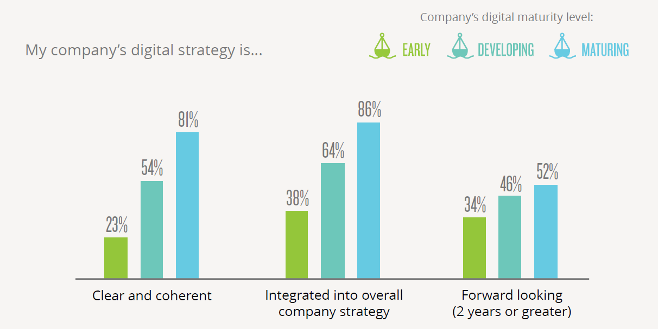
3. Five Essential Management of Technology Issues
3.1 Digital Strategies are Evolving ¹
Zoom Out and Zoom In – Consider 10+ years, address 12 months
1. Kane, G., et al, 2016, “Aligning the Organisation for Its Digital Future”, MIT Sloan Management Review, http://sloanreview.mit.edu/projects/aligning-for-digital-future/

Slide 5
3.2 Technical Knowledge
Most successful companies much more focused on radical evolving technologies
1. Burdon, S., 2017, “How to Harness Disruptive Technology and Foster an Innovation Culture” Criteria Publishing, http://www.criteriapublishing.net/ ISBN9780646968407

Slide 6
3.3 Digital Imperatives
1. Burdon, S., 2017, “How to Harness Disruptive Technology and Foster an Innovation Culture” Criteria Publishing, http://www.criteriapublishing.net/ ISBN9780646968407
Notes:
Scores below 50 very poor
Scores 50-59 poor
Scores 60-65 average
Scores 66-74 good

Slide 7
3.4 Expected Share of Organisational Growth from Digital Initiatives
Percentage of overall growth from digital efforts
Most successful companies have 42% higher growth from digital initiatives
1. Burdon, S., 2017, “How to Harness Disruptive Technology and Foster an Innovation Culture” Criteria Publishing, http://www.criteriapublishing.net/ ISBN9780646968407

Slide 8
3.5 Board Support and Engagement in Digital Strategy
None of the least successful were highly supportive and directly engaged, cf. 21% for most successful.
The most successful had 300% higher scores for either highly or supportive and directly engaged.
The least successful boards’ scores were 74% less than their CIOs and CEOs cf. 20% for successful.
1. Burdon, S., 2017, “How to Harness Disruptive Technology and Foster an Innovation Culture” Criteria Publishing, http://www.criteriapublishing.net/ ISBN9780646968407

Slide 9
4.0 Prerequisites for a Digital Innovation Culture
4.1 Leadership
Next Gen CEOs require to be humble, have transformative vision, technology understanding, ability to establish an innovation culture
4.2 Organisational design
Build a hyperarchy structure to provide agility, encourage multiple collaborations, quick decision making and flexibility
4.3 Corporate Values
Refocus MBV to humanising the attitudes and actions required to establish an innovation culture rather than the emphasis on ethical and social values
1. Burdon, S., 2017, “How to Harness Disruptive Technology and Foster an Innovation Culture” Criteria Publishing, http://www.criteriapublishing.net/ ISBN9780646968407

Slide 10
5.0 Establishing a Digital Innovation Culture
Implementing five of the ten issues studied was a major differentiator between the organisations
Being adaptable and easily embracing change (37%)
Organisations are part of an interlinked community. (36%)
Values doing, taking risks and experimenting over detailed and methodical planning. (34%)
Build a network of innovation resources internally and externally. (29%)
Actively encouraging and rewarding people who generate and drive ideas. (28%)
1. Burdon, S., 2017, “How to Harness Disruptive Technology and Foster an Innovation Culture” Criteria Publishing, http://www.criteriapublishing.net/ ISBN9780646968407

Slide 11
Summary
“Any responsible company today should view digital technologies as a means to create a more efficient organisation or a different form of customer engagement, irrespective of how physical the product may be.”
Arun Sundararajan, 2016, The Sharing Economy, MIT Press
Effective change management is imperative to making the transformation from “doing” digital to “being” digital.
Kane, G., et al, 2016, “Aligning the Organisation for Its Digital Future”, MIT Sloan Management Review, http://sloanreview.mit.edu/projects/aligning-for-digital-future/

