Slide 1





Disruptive Innovation – The Industry Challenge
Professor Steve Burdon
18 October 2017
Union, University and Schools Club
Sydney, NSW

Slide 2
1. Why is Digital Innovation important?
Business model disruption “Technology is set to cause business model disruption for all industry sectors.” ¹
Current global situation ²
  “87% of respondents believe digital technologies will disrupt their industry.”
  “44% feel their organisations are adequately preparing for disruptions projected to occur in their industry due to digital trends.”
1. Burdon, S., 2017, “How to Harness Disruptive Technology and Foster an Innovation Culture” Criteria Publishing, http://www.criteriapublishing.net/ ISBN9780646968407
2. Kane, G., et al, 2016, “Aligning the Organisation for Its Digital Future”, MIT Sloan Management Review, http://sloanreview.mit.edu/projects/aligning-for-digital-future/

Slide 3
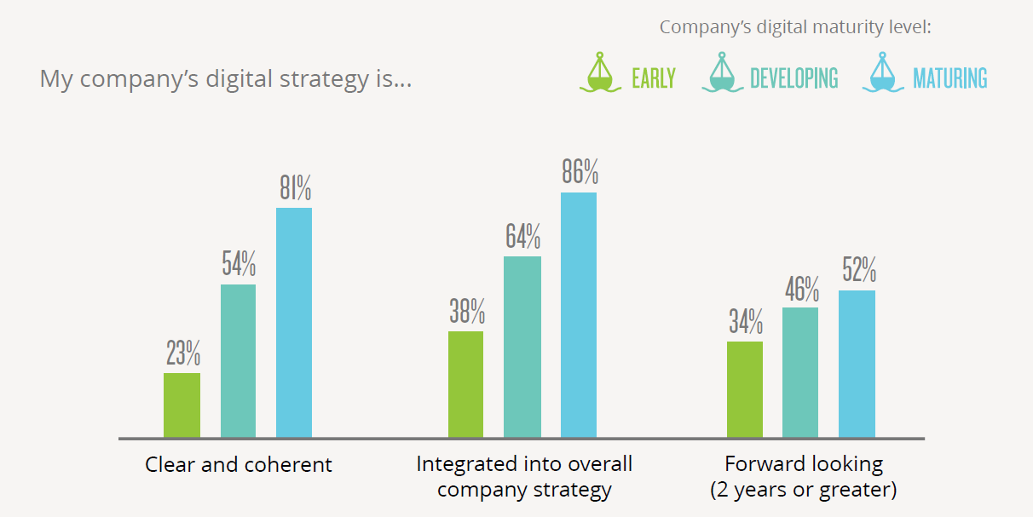
2. Five Essential Management of Technology Issues
2.1 Digital Strategies are Evolving¹
Zoom Out and Zoom In – Consider 10+ years, address 12 months
1. Kane, G., et al, 2016, “Aligning the Organisation for Its Digital Future”, MIT Sloan Management Review, http://sloanreview.mit.edu/projects/aligning-for-digital-future/

Slide 4
2.2 Technical Knowledge
Most successful companies much more focused on radical evolving technologies.
1. Burdon, S., 2017, “How to Harness Disruptive Technology and Foster an Innovation Culture” Criteria Publishing, http://www.criteriapublishing.net/ ISBN9780646968407

Slide 5
2.3 Digital Imperatives
1. Burdon, S., 2017, “How to Harness Disruptive Technology and Foster an Innovation Culture” Criteria Publishing, http://www.criteriapublishing.net/ ISBN9780646968407

Slide 6
2.4 Expected Share of Organisational Growth from Digital Initiatives
Percentage of overall growth from digital efforts
Most successful companies have 42% higher growth from digital initiatives.
1. Burdon, S., 2017, “How to Harness Disruptive Technology and Foster an Innovation Culture” Criteria Publishing, http://www.criteriapublishing.net/ ISBN9780646968407

Slide 7
2.5 Board Support and Engagement in Digital Strategy
None of the least successful were highly supportive and directly engaged, cf. 21% for most successful.
The most successful had 300% higher scores for either highly or supportive and directly engaged.
The least successful boards’ scores were 74% less than their CIOs and CEOs cf. 20% for successful.
1. Burdon, S., 2017, “How to Harness Disruptive Technology and Foster an Innovation Culture” Criteria Publishing, http://www.criteriapublishing.net/ ISBN9780646968407

Slide 8
Summary
“Any responsible company today should view digital technologies as a means to create a more efficient organisation or a different form of customer engagement, irrespective of how physical the product may be.”
Arun Sundararajan, 2016, The Sharing Economy, MIT Press
Effective change management is imperative to making the transformation from “doing” digital to “being” digital.
Kane, G., et al, 2016, “Aligning the Organisation for Its Digital Future”, MIT Sloan Management Review, http://sloanreview.mit.edu/projects/aligning-for-digital-future/

