Slide 1


Managing Risk and opportunity in Tourism:
The impact of COVID-19 on Global Tourism Resilience
Dr David Beirman ©: Senior Lecturer Tourism University of Technology Sydney (Australia)
Presentation to Roundtable Human Rights in Tourism: 28 September 2020

Slide 2
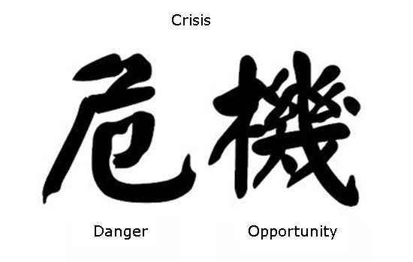
Crisis in Mandarin defines the choices we adopt

Slide 3
Core Themes of Risk and Crisis in tourism
HUMAN CRISES
Terrorism
Crime
Technological Failure
Own Goals- Management and operational failure
Political instability
Economic Crises
NATURAL WORLD CRISES
Natural Disasters
Environmental Crises
Medically induced crises/ pandemics
COVID-19 (a theme in its own right)

Slide 4
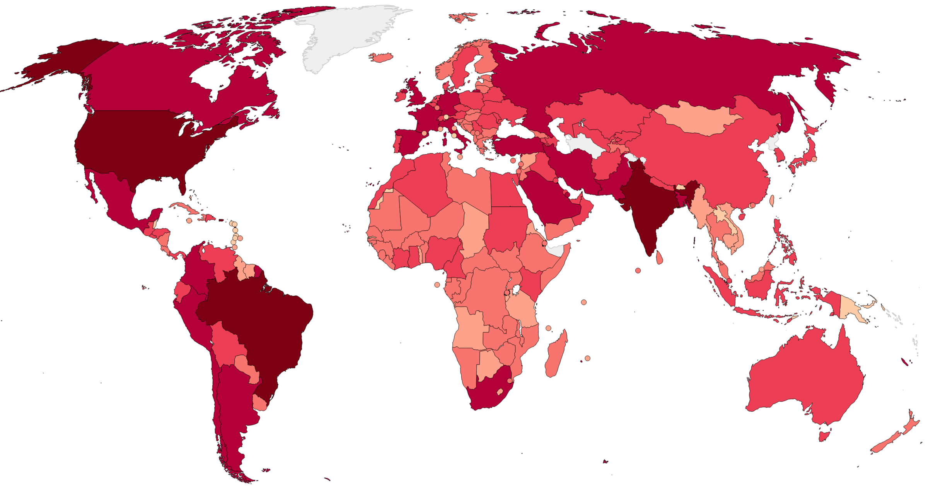
The Global Spread of COVID-19 as of 15 SEPTEMBER 2020 Darker colours demote higher levels of cases and deaths

Slide 5
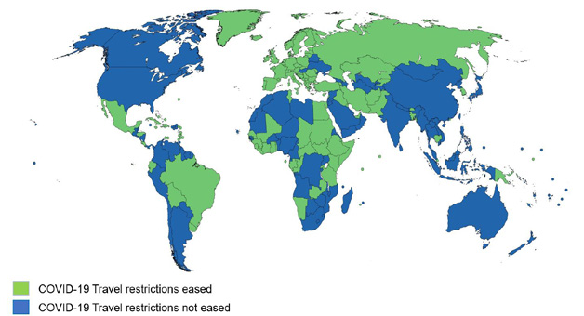
UNWTO Map showing Destinations which have eased Travel restrictions as of 01Sep, 2020: Source UNWTO 2020

Slide 6
What Makes COVID-19 Unique among Tourism crises since world War II ?
Global Extent of restrictions and limitations on travel and tourism
All Sectors of the tourism industry are affected
Widespread closures/ quarantine restrictions applied to cross both international and intra-national borders
Social distancing regulations which restrict or prohibit social or business events and gatherings involving groups of people

Slide 7
pre: Covid-19 paradigms of Tourism
Tourism was set for endless growth
Humanity enjoyed a “right” to travel domestically and internationally
Tourism was increasingly affordable and socially democratic
Tourism was regarded as overwhelmingly desirable by governments
Tourism was a growth industry for jobs and economic opportunities especially for developing countries
Tourism protected indigenous cultures and the natural environment

Slide 8
COVID-19 Tourism Paradigm Myth Busters
Tourism movements heavily restricted globally affecting tourists and tourism businesses
Massive job losses in tourism 100 million + in 2020
International tourism is only available to the financial and social elite although this may change
Health considerations overrule tourism, hospitality business needs
Economies heavily reliant on tourism are either in recession or depression
The rapid & severe decline in tourism. Recovery will take years.
Tourism’s fundamental vulnerabilities have been exposed.
Sustainability has been enhanced by the absence of tourism in some destinations

Slide 9
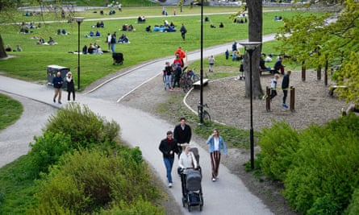

Models of Managing COVID-19 In communities: Open Contact-Lockdown
Impact of these models on tourism
SWEDISH Model open contact VICTORIA (Australia) Lockdown

Slide 10
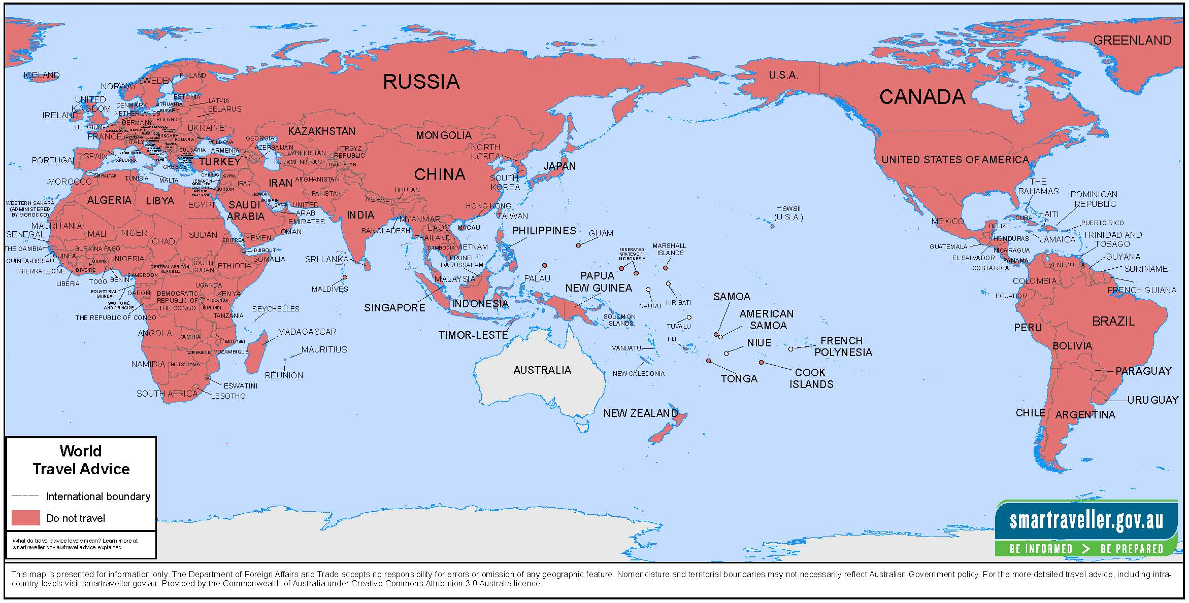
Covid-19 The most severe challenge to the viability of Global Tourism since the Spanish Flu of 1918-19. Since March 25, 2020 Australian Travellers have been subject to an International Travel Ban for travel ex Australia
Note that since late March, 2020 DFAT has banned Australian citizens except for certain exemptions from travelling to any international destinations.

Slide 11
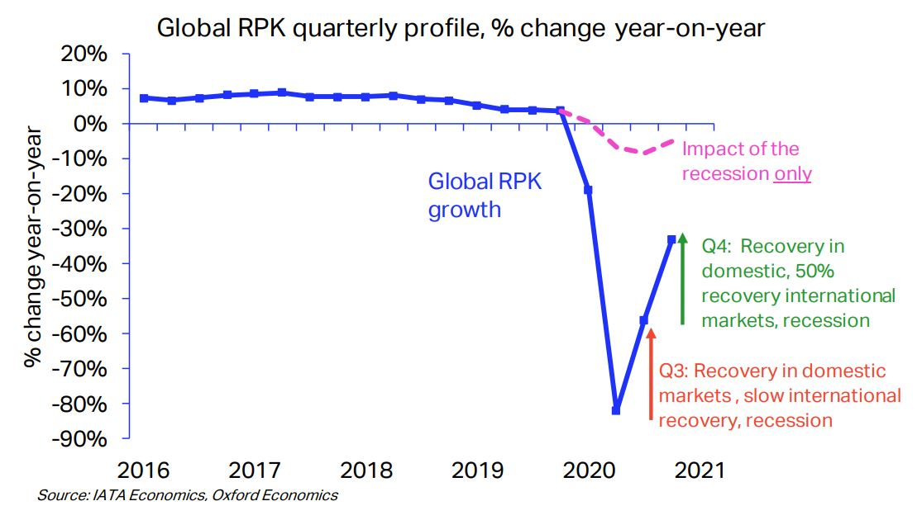
The impact of COVID-19 on Airlines Globally

Slide 12
Tourism Businesses are under Siege
How Can they survive ? Short and Long Term
Key themes:
1. Maintaining and developing cash flow and financial equity
2. Access government support from all tiers of government
3. Diversify and innovate the business
4. Use the downtime for planning, strategic development training and staff development.
5. Prepare for the business resurgence which will follow the virus
6. Special challenges for business travel and the inroads made by IT during the Pandemic

Slide 13

Specific Challenges for
Tour Operators
Focus on a product you CAN market
Pivot towards domestic tourism and “alternative product”
during the Pandemic
Work closely with your principal suppliers to prepare for the opening of borders to your key destinations and explore alternative ‘viable’ destinations
Communicate with your core clientele about programs they
can buy now and what is available soon
Keep the travel dream alive to your staff, stakeholders
and clients

Slide 14

TOURISM’s silver linings around the Dark Cloud of COVID-19
Over tourism under control (temporarily)
Environmental recovery (fewer emissions)
Travellers forced to appreciate the attractions in their own region
Increased focus on carrying capacity
Outdoors and eco-tourism boom
Innovative and virtual tour product which operates within COVID-19 restrictions
An opportunity to re-plan and re-think tourism

Slide 15
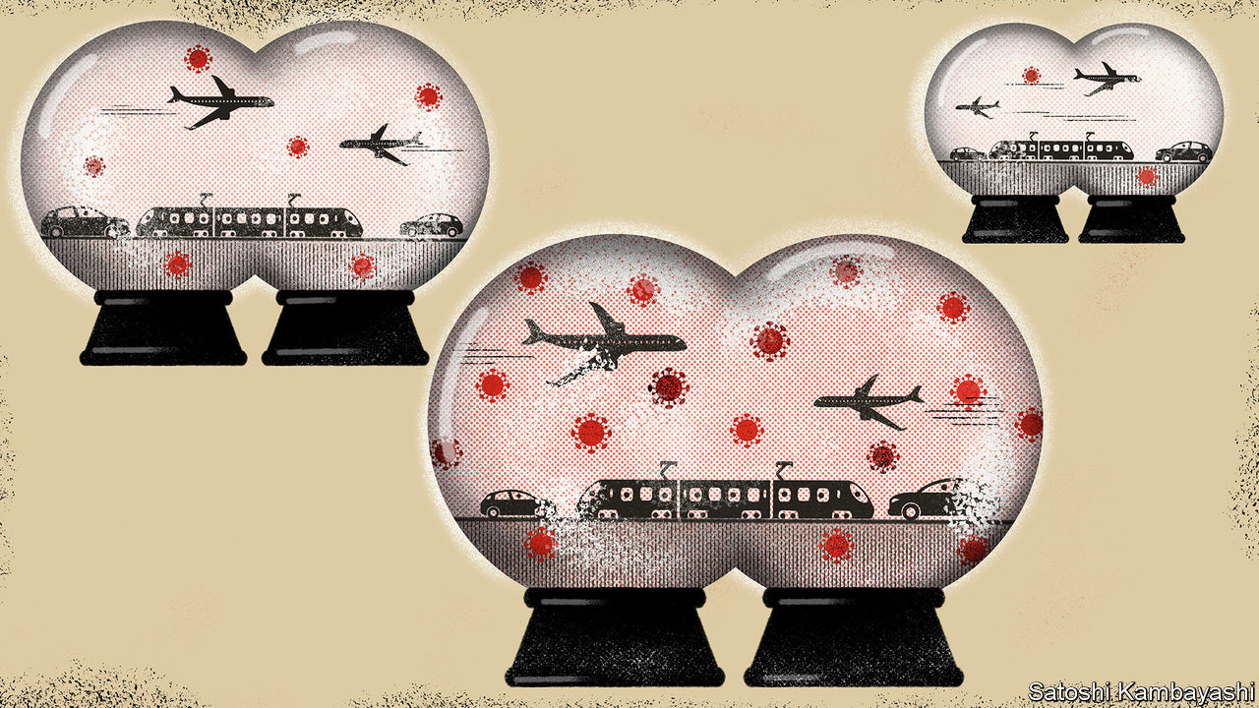
Travel bubbles/corridors
Travel bubble operate widely in Europe with variable success
However, they come with many limitations and conditions
Are there sustainable bubbles which will minimise
the tourism footprint?
In some European countries resuming travel
has been accompanied by a pandemic
resurgence

Slide 16
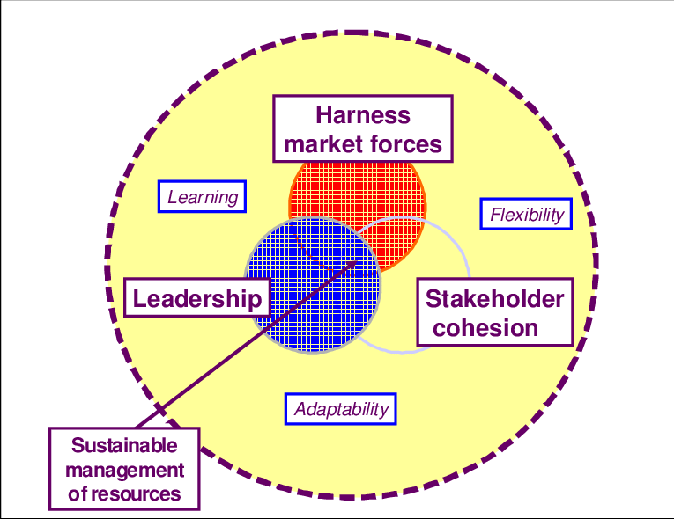
The core Concept of Business Resilience
Source Cochrane (2010)

Slide 17
Successful Post Pandemic Tourism recoveries
2003 PATA’s Project Phoenix facilitated recovery in Asia from SARS
2009-10 H1N1 (Swine Flu) vaccination + Effective crisis communication reduced H1N1 from a crisis to a hazard
2016-2017 Zika in Brazil and the tropical Pacific. Isolating the problem and contextualising the condition and communicating preventative treatment

Slide 18
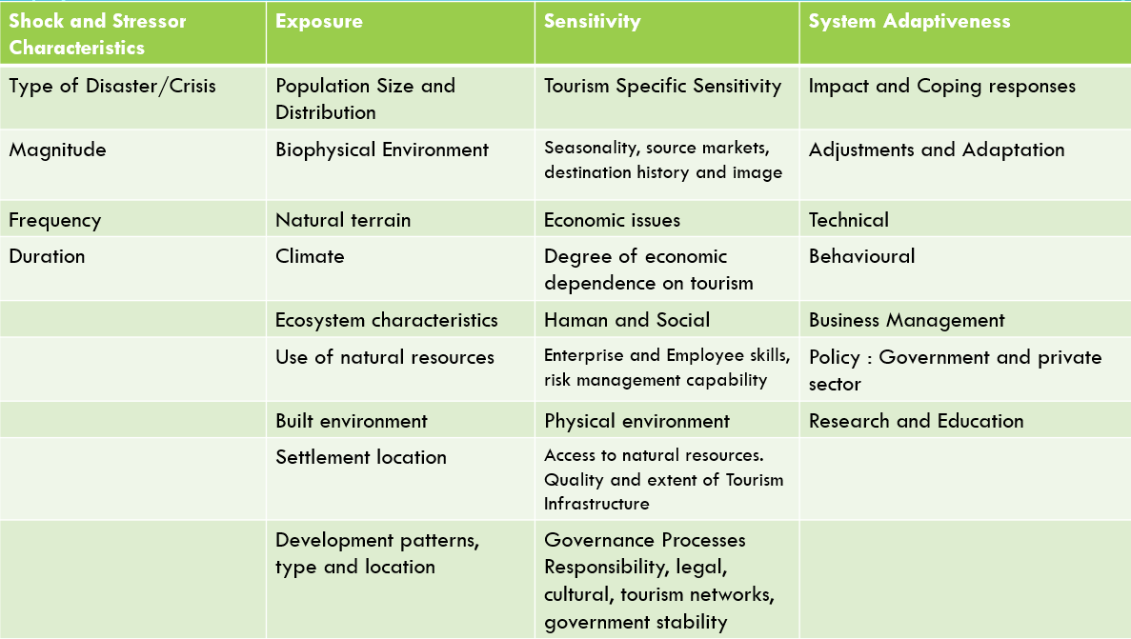
Sustainable Tourism Resilience Framework Calgaro et al 2014

Slide 19
Core Principles for Global Tourism recovery
Inter- sector unity of purpose. We are all in this together
Internalising the lessons learned. Can we still continue to be a high volume low margin business? How do we maintain the sociability of travel without compromising health ?
The centrality of sustainable tourism in post pandemic tourism
To what extent can we restore the human rights dimension of tourism ?
No sacrificing of sustainability for quick bucks
Restore the reputation, appeal, trust and sustainability of tourism

Slide 20
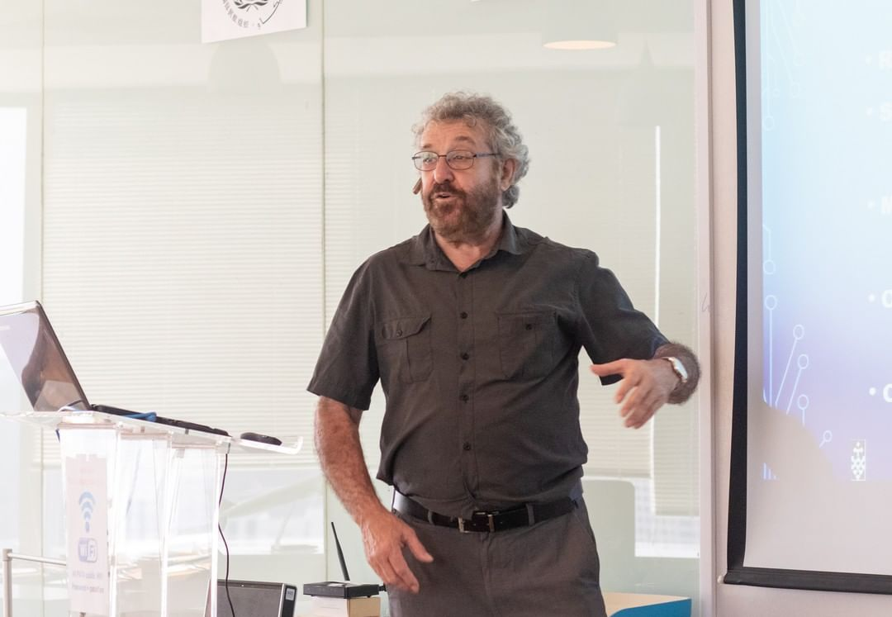
Thank You
Questions welcome
David.beirman@uts.edu.au

