Slide 1
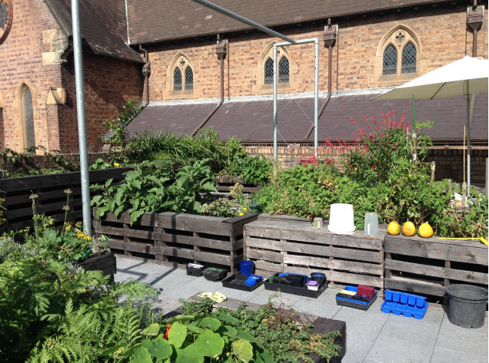
‘A Little Sanctuary’: An Evaluation of the Impact for participants of a Horticultural Therapy Program in Inner Sydney
Fiona Orr – Faculty of Health, University of Technology Sydney
Sara Wilkinson – School of Built Environment, University of Technology Sydney

Slide 2
The GROW Horticultural Therapy program was supported by a 2016 Health Futures Development Grant, Faculty of Health, University of Technology Sydney.

Slide 3
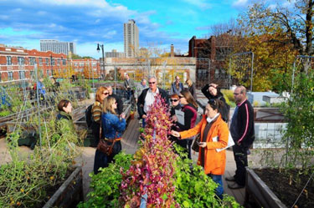
Background
Considerations for Recovery:
housing, opportunities for social interaction and connections, health and wellbeing
Benefits of green space:
social interaction, leisure pursuits, physical exercise, stress reduction, and enjoyment
Rooftop Space:
17% of CBD roofs can be
retrofitted for green space and
garden use

Slide 4
  Horticultural Therapy
Horticultural Therapy utilises green spaces, including rooftop gardens, to increase social participation and improve health and wellbeing (Clathworthy et al, 2013; Kam and Si, 2010).
Led by a trained horticultural therapist
Undertaken in small groups
Benefits for people with a range of health conditions

Slide 5
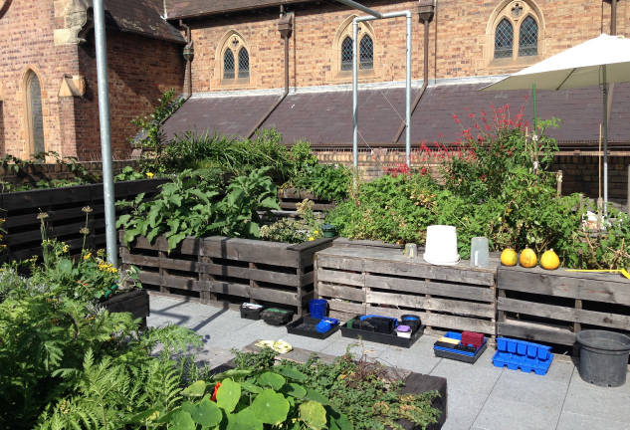
  GROW Horticultural Therapy
Design:
Qualitative research design
Setting:
55 m² rooftop of the St Canice’s Church hall Kings Cross, Sydney, vegetables, shrubs, flowering plants, and herbs
Participants:
People who previously used St Vincent’s Mental Health Services,
5 consented to participate in the study
Two researchers and two staff from St Vincent’s MHS

Slide 6
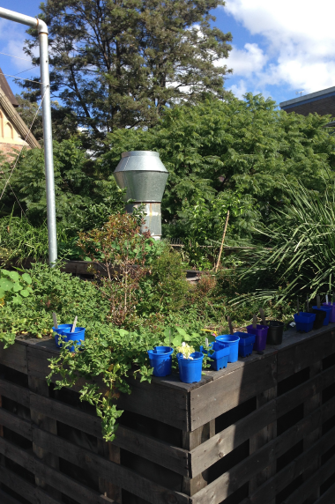
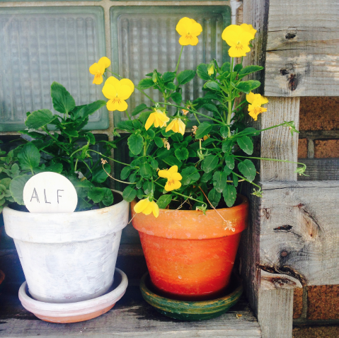
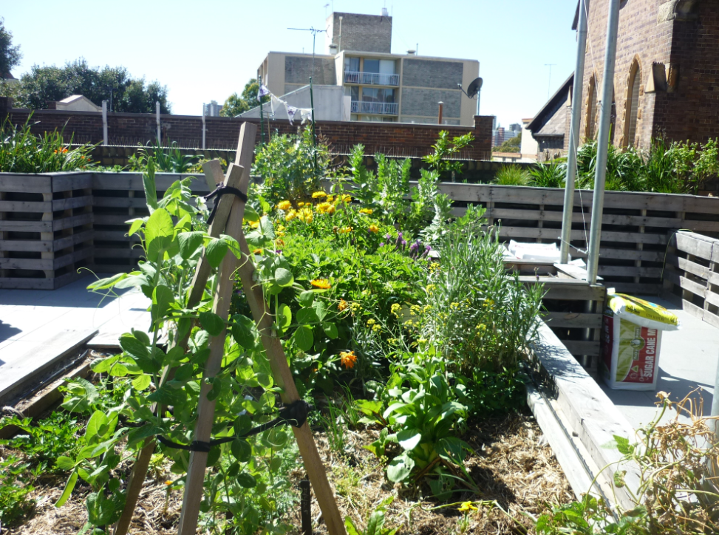
HT program:
comprised weekly, 2-hour sessions for eight weeks, led by a horticultural therapist, supported by a professional gardener:
gardening activities, art/craft in the garden, cooking with herbs, herbal teas and medicine
Data collection: semi-structured, audio-recorded, focus group interviews
Data analysis: thematic analysis of transcribed interviews

Slide 7
Findings
Four major areas of impact:
Health and wellbeing
Social connection
Learning and skill development
Meaning and Direction

Slide 8
Snapshot of the Findings
Improved Health and Wellbeing
Its helping me with my voices, its taken my mind off them. (P3)
Walking to and from GROW group…which is a bit of a hike…and it’s a bit physical as well on occasions, lifting the hot compost…and re-potting things and watering (P2)
The herbs have healing properties…they work on metabolism…they help with sleeping, your mental health, and digestion. (P1)
It’s something I don’t have access to…but it means a lot…just to do some physical work in the garden. (P4)
If this is therapy, bring it on, give me more of it. (P3)

Slide 9
Snapshot of the Findings
Improved Health and Wellbeing (continued)
It’s like a little haven or a little sanctuary to come to every week…and there’s lots of different plants and they produce oxygen for us. It’s just a beautiful place. (P5)
The church as a backdrop...sort of gives it a serene sort of quality...and the space itself is well designed (P2)
I’m coming here to enjoy myself and take away the benefits of the group…and I walk out with a smile every time I walk out of this place. (P3)

Slide 10
  Snapshot of the Findings
Social Connection
Its good to see people on a regular basis that you talk with and get to know…you look beyond their mental condition…they are real people…and it helps a lot with my mental health problems. (P2)
Every Wednesday, it gives me a bit of companionship. (P1)
It makes me be active in socialising with people in the group… and as we were working we were working together…and I much prefer being with a group, doing a group activity. (P5)
Just to be surrounded by nice people, and listen to other people’s experiences…its been great to meet everybody. (P3)
I’m a people person and I like people…but it’s more than just social. It’s the realisation that we’re all on a journey. (P4)

Slide 11
Snapshot of the Findings
Learning and Skill Development
Its been a huge learning curve for me. (P1)
Gardening skills, spacing of plants…and re-potting. (P5)
Learning about drying herbs,,,and when I get home, I think I will start doing it. (P4)
Passion for gardening and using herbs…Mixing and blending herbal teas. (P2)
We touched on a variety of different activities... the painting and drawing... and how they relate to nature and plants in particular...which were all interlinked and woven into an interesting course. We developed quite a lot of different skills...The plant I’m going to take home at the end of the course... I keep thinking of things I can use the oregano for, like a Greek salad. (P2)

Slide 12
Snapshot of the Findings
Meaning and Direction
You can sort of structure your week around GROW. (P2)
Expanding your awareness of where you are, and who you’re with, and what you’re doing, that was really useful. (P5)
It’s something I look forward to, and it’s also something that I can reflect back on during the week …it is a highlight of my week. (P3)
It is sort of a constructive way of …of putting you in the right frame mentally to think about healing yourself…how to grow yourself each week for the rest of the week. (P2)

Slide 13
Conclusions
The study demonstrates the rationale for a rooftop horticultural therapy (HT) program in a high-density urban environment
Participants’ self-reported impacts of the GROW HT program included:
improved health and wellbeing
social interaction and connection
a range of skill development
meaning and purpose
Rooftop HT is one means of enhancing mental health and well being

Slide 14
Spreading the Word and Future Studies
2ser Think:Health interview - 2 May 2017
Article in the Conversation ‘Biophilic urbanism: how rooftop gardening soothes souls’ – 17 May 2017
Future study:
St Vincent’s HS Rooftop Garden collaborative project
Garden design competition with UTS students – winner announced
Stay tuned….Garden installation and HT programs

