Slide 1
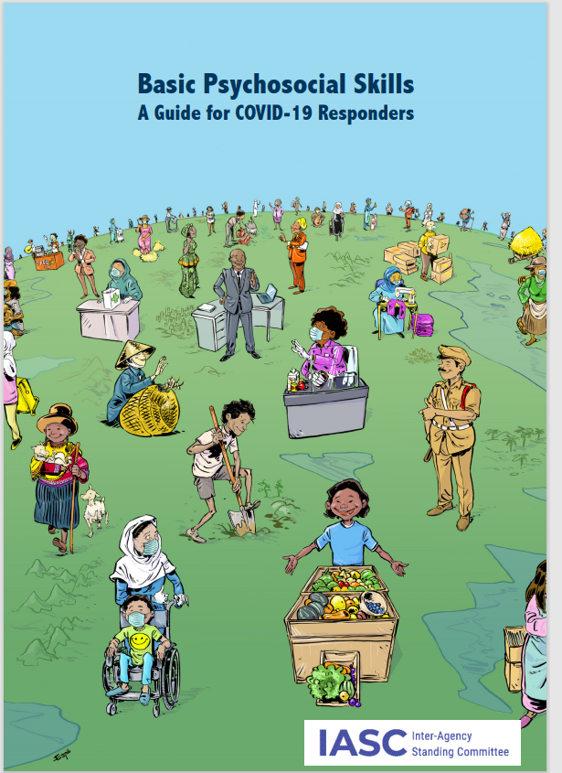
Basic
Psychosocial Skills Guide for COVID-19 Responders
Notes:
Note to facilitators: We suggest that you send the IASC Basic Psychosocial Skills Guide: A Guide for COVID-19 Responders to the group prior to the training and encourage them to read it, so they can familiarize themselves with the skills.
Length of training: The training is designed so that you can adapt it to fit into your schedule. However, the training as it is (including discussions) will take approximately three hours (half a day). To make the training longer (e.g. a full day), you can add in role-plays to allow participants to practise the skills themselves and more in-depth discussion of each of the skills. To make the training shorter, you can reduce some of the discussion time (although we would not recommend this).
Breaks: We have suggested a break halfway through the training (at slide 24). Please adapt breaks to fit your schedule.
Platform: We have written this training for use with online platforms (e.g. Zoom, Skype). It can be easily adapted for use in person through changing the discussions over chat to group or pair based, with verbal feedback.
Ground rules: We suggest that you set some ground rules at the beginning of the training, i.e. a set of rules that the group agrees to adhere to in order to support a safe and smooth learning experience (e.g. muting themselves when not speaking; not interrupting others; respecting break times; maintaining confidentiality within the group).
Audio file: An audio version of the case study on slide 20 has been made and can be found at the following link. You are free to use and share this file: https://drive.google.com/file/d/1r-log0elHEzzSrSmUZSsVaLR4FyY0kSf/view?usp=sharing

Slide 2
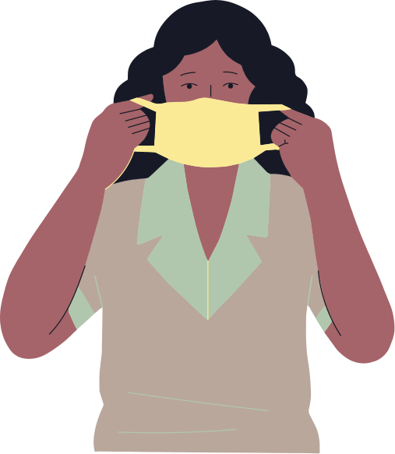
Aims of Training
Today's Agenda
  To Introduce you to the resource 'Basic Psychosocial Skills: A Guide for Covid19 First Responders
  To learn what basic psychosocial skills are
  To learn how to use basic psychosocial skills in the COVID-19 response to help others feel supported.
But first- Time for Introductions!
Notes:
Welcome participants.
– Introduce yourself (name/organization).
– Length of training, any breaks.
– Share information about how the training will run and how online software will work, e.g. how participants can ask questions (raise hand, wait until the end). Ask all participants to mute themselves, or you mute them. Ask participants to turn on their cameras if the connection allows this, to increase participation.
– Introduce the background of the training – based on the IASC MHPSS RG Basic Psychosocial Skills Guide for COVID-19 Responders.
– Aims of training.

Slide 3
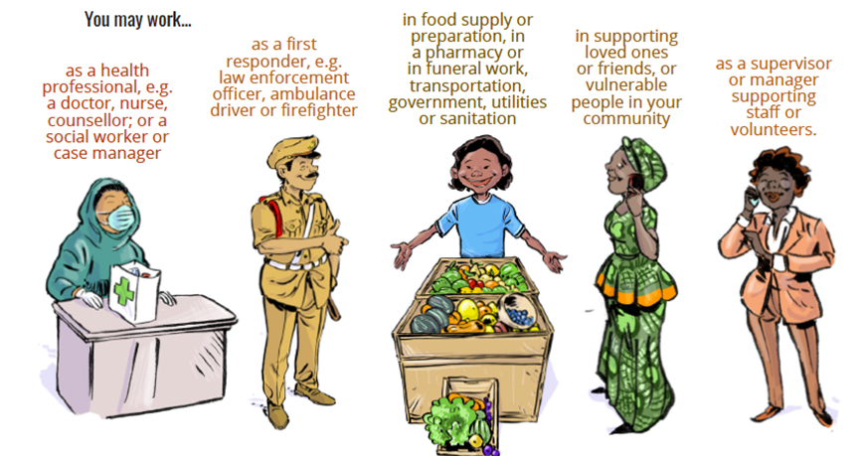
Who can use basic psychosocial skills?
Notes:
Facilitator instructions:
– Summarise some of the roles mentioned in the chat by the participants and reflect how these roles relate with the ones shown in the slide.

Slide 4
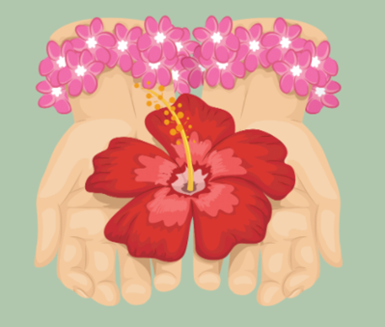
Psychosocial Skills
• are at the core of supporting others to feel supported
• can be used to support the well-being of those you come into contact with
• can support you to perform your role
• can be used with anyone.
When you think of a recent interaction that you had with someone where you felt supported, there were probably some things that they did that were helpful. Can you think of what they were?
Notes:
Facilitator instructions:
Reflection exercise:
– Read the question to the participants and allow a couple of minutes for them to think about it and write their answers.
– Ask participants to write their answers in the chat, and read out 2–3 answers which relate to basic psychosocial skills (e.g. “I see you wrote that the person made you feel cared for. Showing kindness is a form of psychosocial skill”).

Slide 5



What are psychosocial skills?
Everyday Interactions
•Helping others feel comfortable with you
•Listening and communicating
Practical Support
•Providing practical support
•Linking with other organizations
•Helping people to manage their own problems
Emotional Support
•Using listening and communication
•Encouraging people to help themselves
•Providing suggestions to help them
•Helping those who are seriously distressed
Notes:
Everyday interactions:
Helping others feel comfortable with you
Listening and communicating
Practical support:
Providing practical support
Linking with other organizations
Helping people to manage their own problems
Emotional support:
Using listening and communication
Encouraging people to help themselves
Providing suggestions to help them
Helping those who are seriously distressed

Slide 6

Why Are Basic Psychosocial Skills Important in the Covid19 Pandemic?
In your role, why is it important to support the well-being of those in your
community during the COVID-19 pandemic?
Notes:
Put the question to the group and allow them a few minutes to reflect on it and to write their answers in the chat.
– Read 2–3 responses from the chat or ask those who wrote them to read them out, and reinforce those that centre around the ideas that others will recover more quickly if they are supported, psychosocial skills can stop people experiencing stress, emotional well-being is very important during the COVID-19 pandemic as everyone’s mental health or well-being is affected, etc.
– If the group do not think that psychosocial skills are important, go on to the next slide and use it to explain how psychosocial skills improve recovery, etc.

Slide 7
Why are these skills important?
People will recover better when they feel supported
2
Most people will feel stressed during the Covid19 Pandemic
•
You can make a difference to the
well-being of people through how you interact and communicate
1
3
Notes:
Facilitator instructions:
– Relate any answers from slide 8 to answers on this slide (e.g. “[Name of person] said it was helpful to use basic psychosocial skills in their community, as so many people are feeling stressed and need to find ways to calm down”).

Slide 8
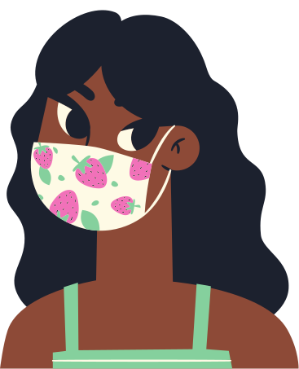

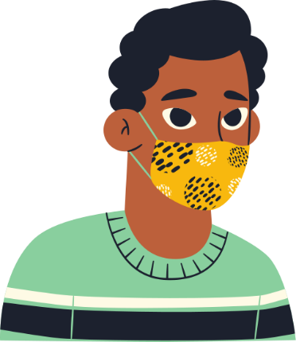
Module 1
Your Wellbeing
Why it is important to look after yourself, and ways to look after yourself.
Notes:
Facilitator instructions:
– Introduce the topic: first we will look at your well-being. Why it is important to look after yourself, and ways to look after yourself.

Slide 9

Before you can look after others, you need to look after yourself.
In the same way that a car needs fuel to drive, you need to look after yourself and keep your tank full so you can keep going. Helping in the Covid19 response is a long distance race, not a sprint, so pay attention daily to your wellbeing.
Notes:
Facilitator instructions:
– Remind the group that the most important thing when working in the COVID-19 response is to look after yourself physically and mentally.
– It is natural to feel stressed when working in the COVID-19 response: there are many demands, and you may be working longer hours, have more responsibility and be worrying about your and your family’s safety.
– Looking after others is hard. In order to be able to look after others, you need to keep yourself healthy.

Slide 10



What do you do to look after your own wellbeing?
Notes:
Facilitator instructions:
– Ask participants the question, and allow them a couple of minutes to reflect on it and to write their answers in the chat. Reinforce answers that display positive coping strategies (e.g. dancing, eating well, sleeping well).
– If someone mentions an unhelpful coping strategy (e.g. drinking alcohol), explain that it may appear to help in the short term, but in the long term it will cause more problems such as sleep disturbance, aggression and increased stress. So we recommend that people do not drink alcohol or consume other substances that can cause problems in the long term.

Slide 11
Looking after yourself.
Talk to your manager or supervisor about your wellbeing at work.
5
Establish daily routines and stick to them
6
Stay up to date with accurate information about Covid19
1
Avoid use of drugs, alcohol and kava
7
Eat well, get enough sleep and exercise every day
2
At the end of each day make a short list of how you have helped or been successful
8
Do an activity that you enjoy or find meaningful every day.
3
Be realistic about what you can and can't control
9
Take 5 minutes to talk to a friend or family member every day about the way you are feeling
4
Try an activity to relax- see what works for you.
10
Notes:
Facilitator instructions:
– On page 7 of the guide you can find some recommendations for taking care of yourself, including some of the ones you have mentioned

Slide 12
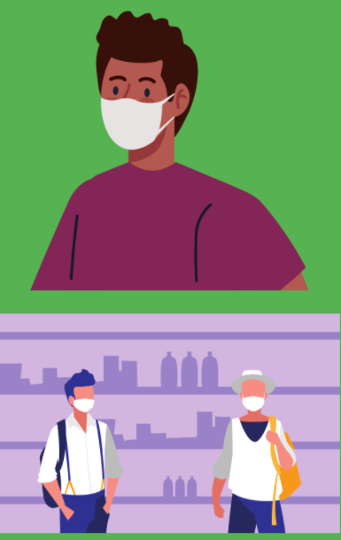
Patrick's story
Patrick enjoys his work as a community leader. However, during the COVID-19 crisis, many community members have lost their jobs and are unable to eat. There are rumours spreading that COVID-19 is not real but a hoax. People started calling Patrick, asking for help and for money. Patrick found himself working long hours listening to community members’ problems. He felt powerless and confused about how best to help. He even lost his temper with one person. He realised that he must do something to look after himself. Patrick made a routine. He put time aside to be with his family and take a walk every day. He made a “control circle” and realised that he could not compensate for people’s lost salaries, so he thought about ways he could kindly explain this to others if they asked. He also identified ways in which he could support others: listening and helping people to support each other. After a week, Patrick felt more relaxed, was able to speak respectfully to community members and was able to do his job effectively for a longer period of time.
Notes:
Facilitator instructions:
– Read the story aloud to the group. Patrick is feeling very stressed and is helped by using some simple strategies to manage his time, energy and health. The story mentions several things that he did that helped.
-Ask participants to identify the things that Patrick did (made a routine, put time aside for family, exercised daily, made a control circle, reflected on what he can and cannot control, thought about how he could explain things to others in a kind way, identified things he could do to help). Control circles will be discussed in more detail later in the training but you could raise it here if people ask to have it explained.

Slide 13
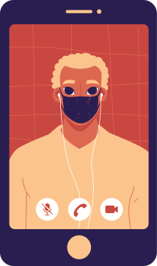
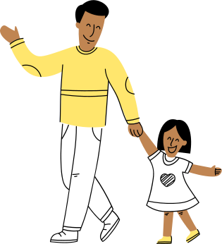

Think of one thing you will do to support your wellbeing today, and tell someone your plan.
Notes:
Facilitator instructions:
– Ask participants to think of one thing they will do today to look after themselves. This can be something they already do, one of the ideas from someone else or one of the suggestions above.
– They do not need to answer in the chat, just tell themselves that they will do this thing, and maybe write it down.

Slide 14
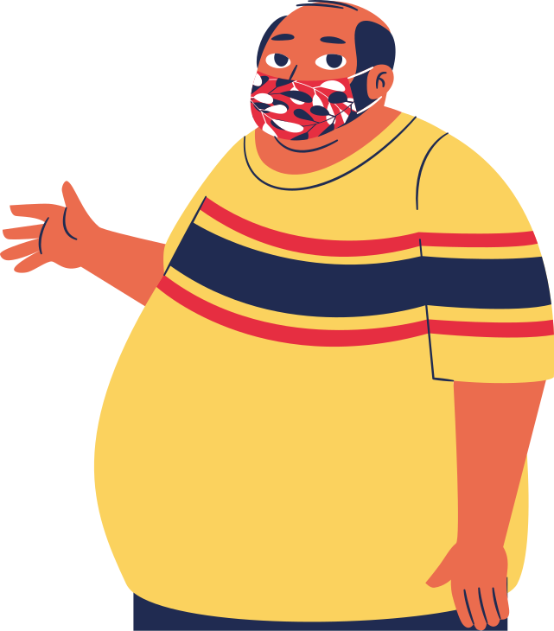
Module 2
Everyday Interactions
Helping others feel comfortable with you
Supportive communication
Notes:
Facilitator instructions:
– Introduce the topic: now we have looked at how to look after your well-being, let’s think about how you can support others through your everyday interactions. We will look at how to help others feel comfortable with you, and how to communicate with them in a supportive manner.

Slide 15
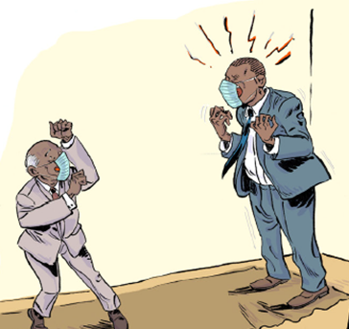
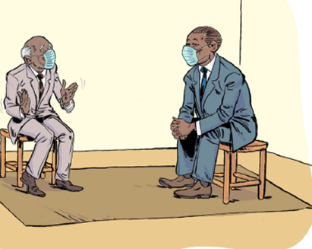
Everyday interactions: Helping others feel comfortable with you
A
B
A
Notes:
Facilitator instructions:
– In the picture, the man in the dark blue suit is Frank, a community leader.
– Ask participants the following questions to start a discussion:
(i) Who would you rather speak to – Frank in scenario A or scenario B?
(ii) Why?
(iii) In A, how is the older man reacting? Do you think he will go to Frank again for support?
(iv) How about in B?
– In the discussion, elicit the following key points:
(i) That how you approach everyday interactions will affect how people see you, and whether they trust you and will come to you for support again.
(ii) In scenario A, Frank is very angry. It is possible to be unsupportive in different ways, for example looking bored or ignoring what someone is saying.
(iii) In order to be approachable, it is important to have a relaxed body posture, to speak calmly, to appear friendly. Remind participants to check the information in the guide on page 9.

Slide 16
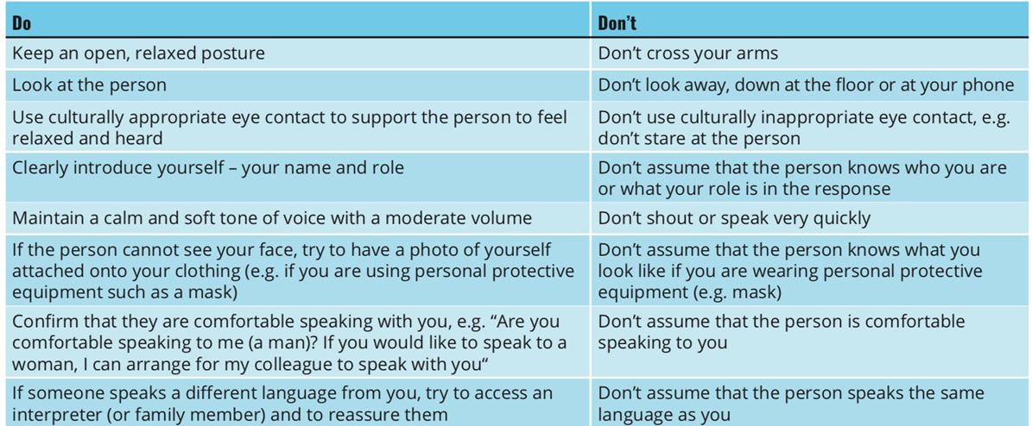
Everyday interactions: Helping others feel comfortable with you
Notes:
Facilitator instructions:
– Show the group the list of “dos” and “don’ts”.
– Link any from the group discussion you have had to the ones here.
– Open up discussion if appropriate around some points, e.g.
“What would culturally appropriate eye contact look like here?”
“What do you think of these points – do any need adapting for your context?”
“What from here can you use in your daily lives?”
– Link any of these points to the answers from slide 4, e.g. if someone felt supported through the way another person approached them.

Slide 17

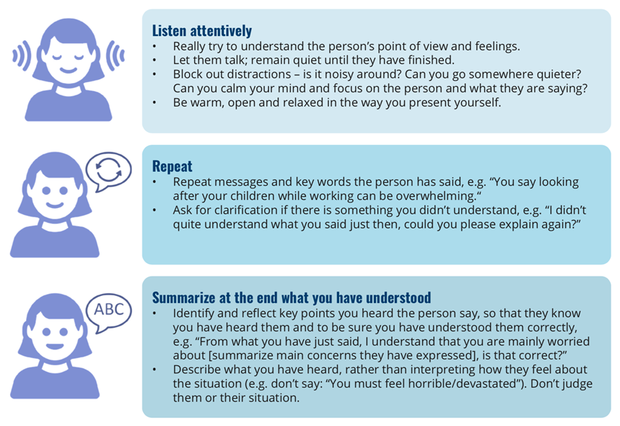
Everyday interactions: Supportive Communication
Notes:
Facilitator instructions:
– Introduce the next section: “Now we have looked at how to help others feel comfortable with us, the next step is to support others through the way we communicate. The first and most important point is to really listen to what the person says. This is a specific technique we can use to show that we are listening. It is called “active listening.”
– Ask the participants if anyone has heard of this; if they have, ask them to explain what it means.
– Reinforce correct answers, and correct wrong answers. Emphasize the three steps in active listening.

Slide 18
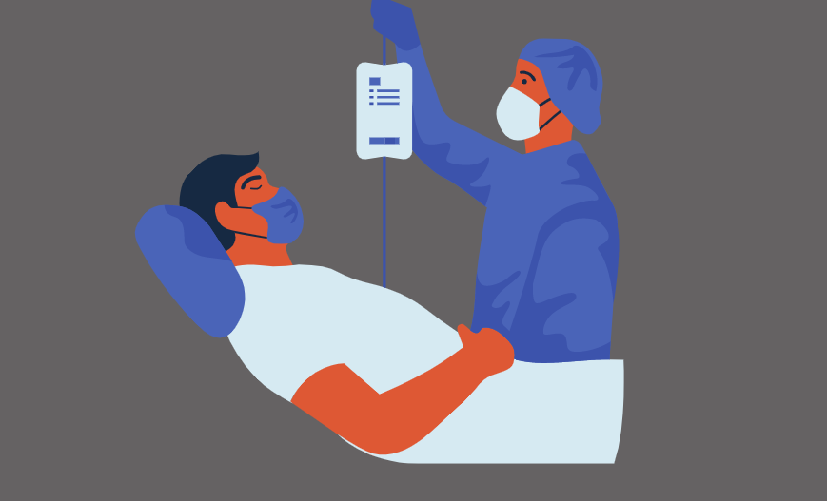
Everyday interactions: Supportive Communication
Show that you care.
Notes:
Facilitator instructions:
– Introduce the picture: Here is Nurse Terry. John is speaking to Terry about how he misses his family.
– Ask the group:
(i) How can Nurse Terry show that he cares with his body language? (Answers: eye contact, calm voice, listening)
(ii) How can Nurse Terry show that he cares by what he says? (Answers: show empathy, e.g. “I’m sorry to hear that”, “That sounds difficult”)
– Reinforce correct answers, and correct wrong answers.
-OR- tell the story to show a great example of active and supportive communication (below).
Terry is a nurse working in a community health centre. One of her patients, John, has COVID-19. John tells Terry that he misses his family, and is scared that he may become more unwell. Terry puts down his notepad to show he is giving John attention, sits down and looks John in the eye as he speaks. Terry nods his head and says “This is such a tough situation”, “I can understand that you miss your family”, “It must be hard not being able to see them”. Later, John tells Terry, “Thank you for listening, I no longer feel alone as you gave me your time and attention.”
This could be a good time to conduct a roleplay activity. Participants have heard some information about verbal and non verbal communication, and now they can put into action. Ask the participants to divide into groups of 3. One participant is the observer, one the person with the worry, and one the responder.
Ask the person with the worry to play the role of a worker who is worried that their job is not secure, and that they may not have work there for much longer. The responder should use the active listening skills that they have heard about so far, focusing on listening to the story being told, using verbal and non verbal communicating to show that they are hearing what is being said, and reflecting back the story they have heard, rather than leaping in with quick fixes themselves. Once the participants have gone through this once (around 2-4 minutes) they should hear feedback from the observer (briefly) then swap roles, until all 3 participants have had a turn in each of the roles.

Slide 19
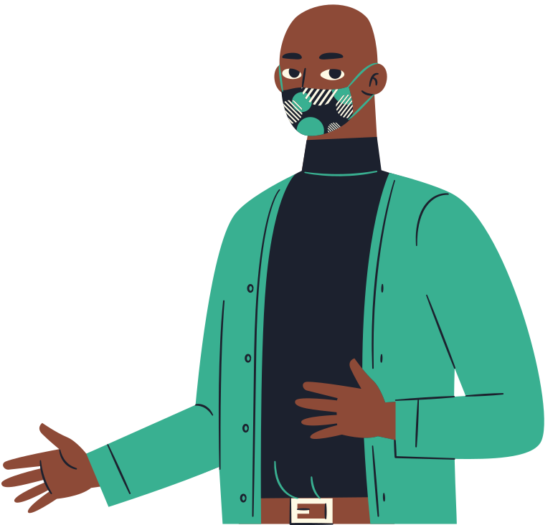
Everyday Interactions- Supportive Communication
•Words
Use supportive phrases to show empathy (“I understand what you are saying”) and acknowledge any losses or difficult feelings that the person shares (“I am so sorry to hear that”, “That sounds like a tough situation”).
•Body language
Includes your facial expressions, eye contact,
gestures and the way you sit or stand in relation to the other person.
Notes:
Facilitator instructions:
– Relate the information on this slide with the answers given by the group.

Slide 20
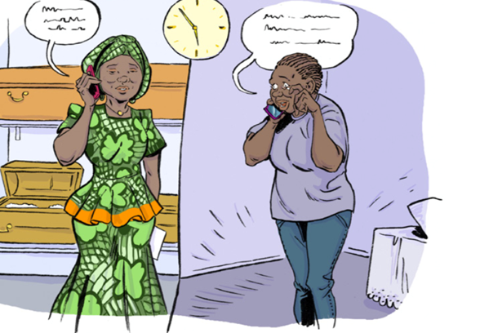
Everyday Interactions- Supportive Communication
Lina, a worker in a funeral parlour, was able to use active listening to support Grace:
Grace: Hi, I need to arrange a funeral for my brother who has… [sobs]
Lina: It’s okay, take your time. It sounds like you are having a difficult time.
[10 seconds of silence]
Grace: Okay, I am here. Yes, thank you. It’s so hard – I can’t believe this has happened.
Lina: I can hear how upsetting this is for you.
Grace: I just don’t want this to be real.
Lina: Mmhmm, I am here, listening.
Grace: I loved my brother so much – we were tight. He was my best friend. And today he passed away.
Lina: It sounds like your brother was very important to you – your best friend.
Grace: Yes, he was my best friend... it’s so tough… I remember all the fun times we had together [laughs a little].
Lina: I am hearing that you are also remembering the fun times too.
Grace: Yes, it makes me smile to think of the fun times. Thank you, my dear, you have really helped me feel better.
Lina: Of course, I am happy to support in these tough times.
Grace: I am now ready to discuss what can be done about the funeral arrangements.
Notes:
Facilitator instructions:
– Explain that you will now do an exercise where you will ask participants to notice what basic psychosocial skills are being used (e.g. listening, showing care).
– Introduce the case study: “Here is Lina, she works in a funeral parlour.”
– Read the script aloud with the group or play the audio file (which can be found at https://drive.google.com/file/d/1r-log0elHEzzSrSmUZSsVaLR4FyY0kSf/view?usp=sharing) or ask two group members to read the script, one pretending to be Grace and one pretending to be Lina.
– Ask the group:
(i) How is Lina showing that she is listening?
Answer: leaving silences, repeating phrases – e.g. “it sounds like your brother was very important to you...”; “I am hearing you are also remembering the fun times too.”
(ii) How is Lina showing that she cares?
Answer: Allowing time and not being in a rush – “I’m happy to support in these tough times.”
(iii) how could Lina have summarized at the end?
Answer: e.g. “You have told me that you are having a difficult time because your brother has died, but now you are ready to discuss the funeral arrangements.”

Slide 21


How could you adapt these psychosocial skills for everyday interactions to remote/telephone working in the COVID-19 response?
·Clearly introduce yourself
·Ask if the person is able to speak
·Clarify any miscommunications or misunderstandings
·Allow for pauses when the person stays silent
·Make helpful comments to normalize silence
·Try to minimize disruptions
·If possible, support the person to both see and hear you when talking, e.g. by using video software.
Notes:
Facilitator instructions:
– Tell the group that these are some suggestions, and link with any that they come up with themselves.

Slide 22


Take a Break for 10 minutes
Have a stretch or take a refreshment break.
Notes:
Facilitator instructions:
– Suggested time for break.
– Inform participants that you will now be taking a 10-minute break.
– Encourage them to stand up and stretch or walk for a bit, and come back in 10 minutes.

Slide 23
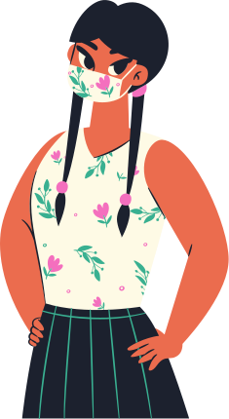


Module 3
Practical Support
•Providing practical support to others
•Linking with other organizations
•Helping people to manage their own problems.
Notes:
Facilitator instructions:
– If you have taken a break, welcome participants back and make sure that they are all there.
– Introduce the next topic: we have looked at how to support people in everyday interactions through how we present ourselves and communicate. Now we are going to look at how to support people who have specific problems. Depending on what problem the person has, you may be able to provide practical support yourself, link with other organizations or help the person to manage their own problems. We will look at these in more detail

Slide 24

Practical Support
What kind of problems have people in your community experienced during the COVID-19 pandemic?
Notes:
Facilitator instructions:
– Put the question to the group and ask them to write their answers in the chat. Highlight 2–3 answers from the group or any themes that come up, allowing those who wrote them to read them or comment.

Slide 25

Practical Support- Providing help yourself.
1
2
3
•Provide information (e.g. about the situation)
•Provide support yourself (e.g. food, water, shopping)
•Don’t feel pressured to provide direct support if you are not able to.
In your role, can you provide direct support?
Notes:
Facilitator instructions:
– Introduce the topic: sometimes you will be able to provide direct support yourself. Here are some example scenarios. Do provide support if you are able to, but remember to keep yourself safe and do not feel pressured to offer support.
– Individually, consider whether you are in a position to provide direct support.
– If possible, link with answers that people came up with in slide 24, e.g. if someone mentioned that people in their community did not know how to keep themselves safe from COVID-19. Here you could provide them with information about how to do this.
– If there is time, ask a member of the group to give an example of when they have provided direct support to help someone.

Slide 26
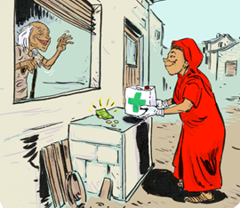
Practical Support: Norma's story
Norma lives in a crowded community. One of her neighbours, Barry, is an elderly man who lives by himself. Norma telephones him and asks how he is doing. Barry says he has not been able to get outside to buy the medicine he normally takes for his hypertension. Norma goes to buy food every week and suggests that she could go to the hospital or pharmacy and buy Barry´s medicine too. They decide on a safe place just outside Barry’s door where he can leave money and Norma can leave the medicine. In that way, they do not have to come into physical contact.
Notes:
Facilitator instructions:
-Ask a participant to read out the story or read it out to the group.
-Ask the group to identify why such a simple act of support could assist Barry? (access to medication, building of trust, realising he can ask for help etc)

Slide 27

Practical Support: Linking in with other organisations
•Create a list of all organizations operating in your area and their contact details. Keep this with you at all times.
•Quickly link people in distress or those who need food, water, shelter or urgent medical or social services.
•Follow up with people if you agree to do so.
Personal Reflection: Do you know all the organisations operating in your area?
Notes:
Facilitator instructions:
– Say to the group: If you are unable to provide direct support yourself, then you can link the person to someone who can provide it.
– Ask group members to individually consider whether they know all of the organizations in their area.
– Comment that If they don’t know them, it is very important that they find out this information after this training.
– If there is time, ask a member of the group to give an example of an occasion when they have provided support to someone through linking to another agency.

Slide 28

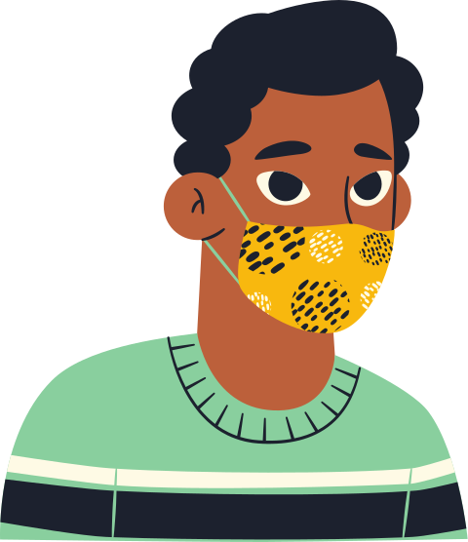
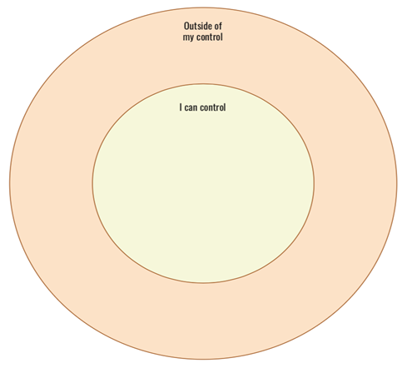
Practical Support: Helping people to manage their own problems
Notes:
Facilitator instructions:
– Explain that another way of providing support is by helping the person to help themselves. You can do this through taking through the “Stop–think–go” approach below.
– Explain that the first part of the process is to “Stop” and choose one problem. To help them do this, you can use the ”circles of control” to help the person decide which problems they can do something about. (You can point people to the annex in which the circles of control are in the manual).

Slide 29
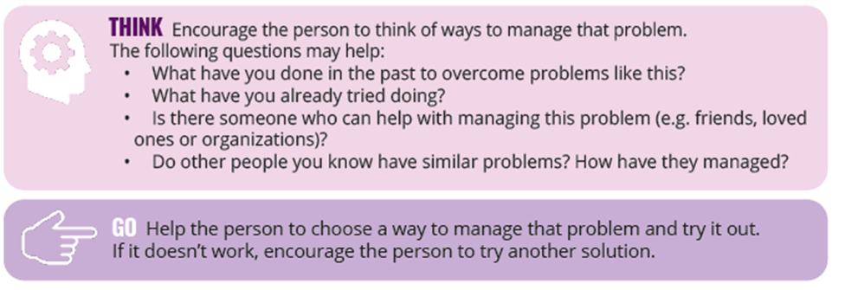
Practical Support: Helping people to manage their own problems
Notes:
Facilitator instructions:
– Explain that once there is one problem identified that the person can do something about, the next step is to “Think”. You can ask a participant to read the section out loud for the others.
- Explain that after a way to manage the problem has been identified, the next step is to “Go” and try out the solution. You can ask a different participant to read the section out loud for the others.

Slide 30
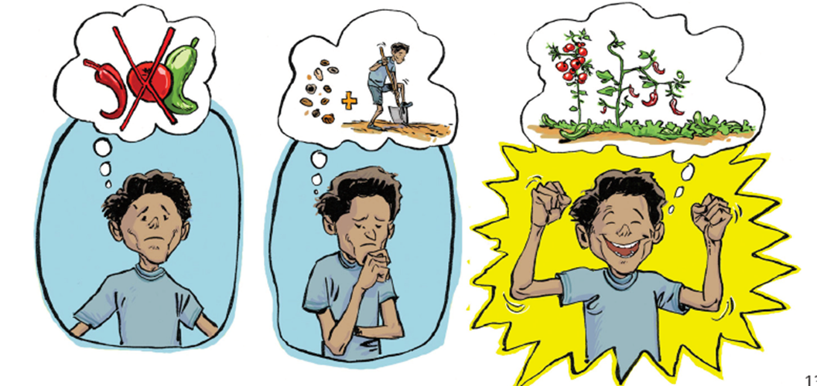
Practical Support: Helping people to manage their own problems
Notes:
Facilitator instructions:
– Take the group through Roger’s example for Stop–think–go:
STOP: Roger says he has many problems – he lives on a remote island, and worries about feeding his family and worries about his wife contracting COVID-19.
We can help him to choose one problem, by asking, “Is there anything you can do about this?” Roger decides that he can do something about both of his problems. He decides that feeding his family is the priority at the moment.
THINK: Next we ask Roger to THINK of all the possible ways to feed his family. Roger struggles to begin with, so he phones his wife, who helps him think of solutions. Together, they think of the following:
1. Begin growing their own food
2. Contact a local NGO or food bank
3. Asking for help from family or community to give him food, perhaps offering to exchange food with neighbours in return for his work.
GO: Finally, ask Roger to choose one solution from the list to try out. Roger has some seeds and would like to grow his own food; however, this will take time. Roger decides to contact a local NGO for food immediately and to begin growing some vegetables in his garden for the future. He has arranged to travel to another island where the NGO is located to enquire about options. If he cannot get help from the NGO, then he will come back to the list of solutions.
– Ask the group for some advantages of supporting Roger to come up with his own solutions (e.g. he will be more motivated to manage the problem, he will feel empowered).

Slide 31
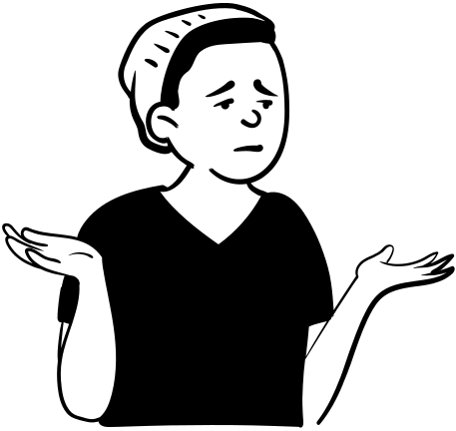
Module 4
Emotional Support
•Use listening and communication
•Encourage people to help themselves
•Provide suggestions to help them
•Helping those who are seriously distressed.
How have people reacted to Covid19 in your community?
Notes:
Facilitator instructions:
– Introduce the next topic: you may come across people who require emotional support. We will look at ways to emotionally support people, through helping them to manage stress themselves and providing support, and how to help people who are seriously distressed.

Slide 32



When someone is feeling distress it can result in...
Emotional Reactions (feeling angry, sad or scared)
Behavioural Reactions
(lack of motivation, avoiding activities, becoming violent).
Physical Reactions (headaches, muscle pain, back pain, difficulty sleeping, lack of appetite)
Notes:
Facilitator instructions:
– Go through the symptoms of stress listed on the slide.
– Point out that these are normal symptoms of stress – a natural reaction to extraordinary circumstances.
– Participants may recognize some of these symptoms of stress in themselves.
– If possible, link these to the answers given for slide 31, e.g. “A lot of people mentioned that they had seen people becoming more aggressive – as can be seen, this is a symptom of stress.”

Slide 33
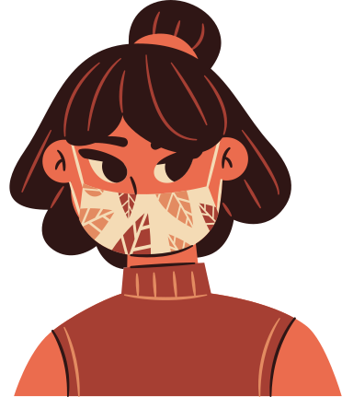
When someone is experiencing stress
Use listening and communication skills
  Help the other person to feel comfortable with you
  Listen
  Show you care.
Notes:
Facilitator instructions:
– Explain that using the listening and communicating skills discussed earlier in “Everyday interactions” can sometimes be enough to support someone to feel better.
– If the person still appears stressed after you have spent time listening and communicating with them, then there are more things you can do to help. We will look at these next.

Slide 34

When someone is experiencing stress
Encourage the person to think of something they can do to feel better.
  “What has helped you previously when you have felt this way?”
  “What do you currently do to help yourself feel better?”
  “Is there anyone who can help you?”
  “Are there any activities you used to enjoy doing that you could do now?”
Notes:
Facilitator instructions:
– If the person still appears stressed after you have spent time listening and communicating with them, then encourage them to think of something that they can do to feel better. Here are some questions which may help.

Slide 35

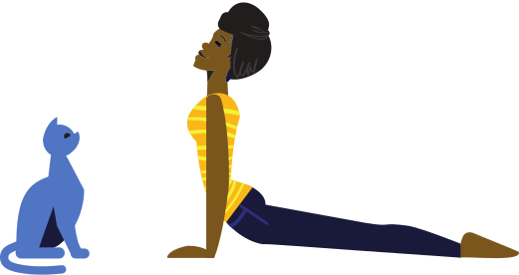

Provide Suggestions to help them
• Do an activity you enjoy or find meaningful (e.g. pray, sing)
•Exercise, walk or dance
•Do something creative, such as art, singing, crafts or writing
•Listen to music or the radio
•Speak to a friend or family member
•Read a book or listen to an audiobook
•Make a list of all the things you are grateful for (in your head, on paper).
Notes:
Facilitator instructions:
– If the person is unable to think of something they can do to feel better, then you can suggest something to do.
– These are suggestions. Please do think of others which may suit your culture.
– Possible reflection question: what other suggestions for activities to help others feel better can you think of?

Slide 36
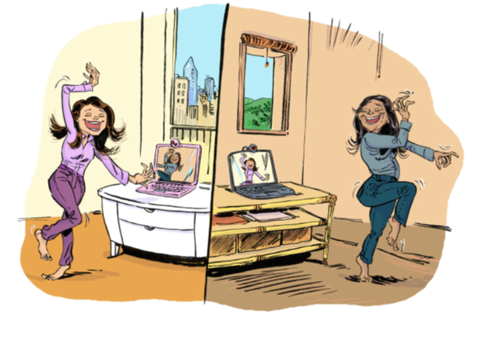
Emotional Support- An Example of Support
Josephine’s partner has been taken into hospital with COVID-19. She is so worried about him that she is not sleeping at night, she cannot eat and she has back pain.
Josephine is talking to her colleague, Julia, on the phone and tells her how she is feeling. Julia listens to her, and shows her support and care. She asks Josephine if there is anything she can do to make herself feel better.
Josephine is so tired that she can’t think about anything at the moment. Her back aches so much…
She realises that she has been at home without walking or moving very much and decides to do some stretches and to dance in the mornings to some nice music, as she and her partner would normally do.
Julia loves this idea and tells her that she can join her by telephone or video call in the morning to stretch and dance too. Josephine is happy about that suggestion and to have her colleague join her in this way.
Notes:
Facilitator instructions:
– Read the story aloud (or ask one of the group to read it).
Ask group members to identify impacts of stress for Josephine (e.g. Not sleeping, worried, cannot eat, has back pain).
Ask the group to identify things that Julia did to help (e.g. Making contact, listening, asks what she can do to help, suggests an activity they can do together, even when they are physically apart)
Note that the use of technology can be highlighted here as helpful (it may be a way for some community members to stay connected even though they cannot visit one another).
Consider also the potential for communication challenges if Josephine lives in a remote location, and how her friend could offer support if this were the case.

Slide 37
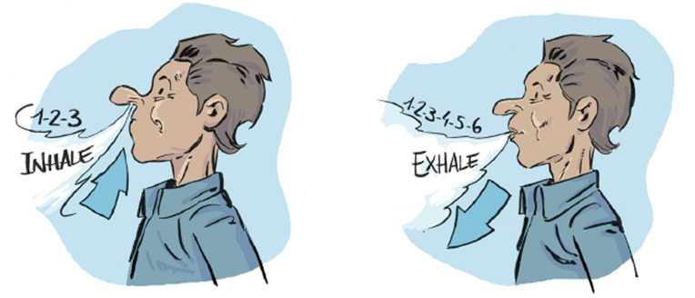
Practising slow deep breathing can be a helpful strategy for some people.
Be mindful of the need for masks and physical distancing.
Notes:
Facilitator instructions:
– Introduce the idea of deep breathing. If the person is agreeable, then take him/her through the deep breathing exercise. Remember that this strategy may not help everyone, and if he/she feels any discomfort then you should stop the exercise.
– Do the exercise with the group: ”Let’s do it all together. If you feel anxious, stressed or overwhelmed, slow and deep breathing can be a great way to help yourself to take a quick break and feel calmer and more able to cope with the situation. Together with me, take a breath in through your nostrils while counting to three. Keep the shoulders down and let the air fill the bottom of the lungs and then exhale slowly through your mouth whilst counting to six. Are you ready?” Guide the counting in and out for the group for at least four repetitions.
– Ask the group how they are feeling after doing the breathing exercise, and if it is something that could help them when they are feeling stressed.
-(Remind the group that social distancing is very important)

Slide 38
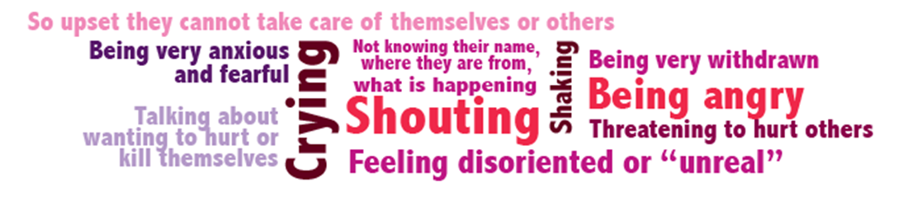
When Someone is Seriously Distressed
they may need to be connected to more specialised support.
Notes:
Facilitator instructions:
– Explain that signs of stress mentioned before are natural and may fluctuate over time. Some people may have longer-lasting and more intense reactions. When this happens, they might be seriously distressed. Feeling serious distress is a normal reaction to extraordinary circumstances, but it can stop people from being able to function. In a situation like this, it is likely that you will need to refer the person on to specialized support. Signs that someone is experiencing serious distress are presented here.

Slide 39
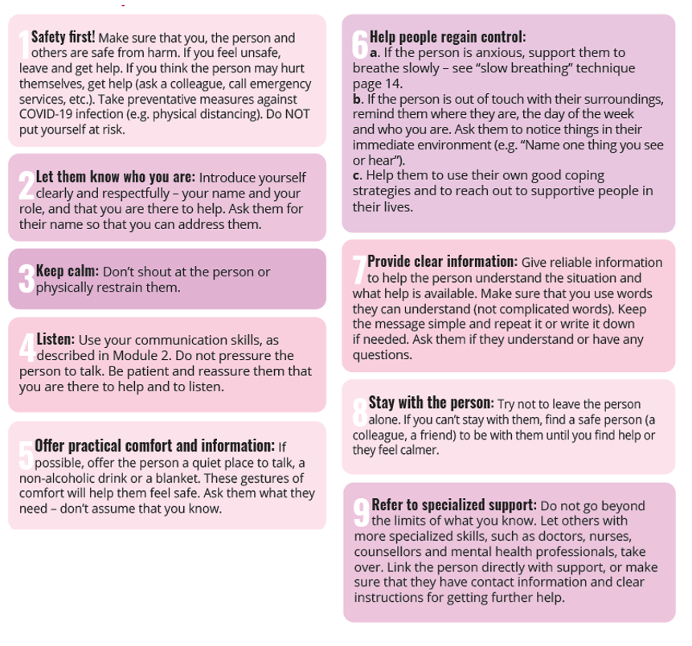

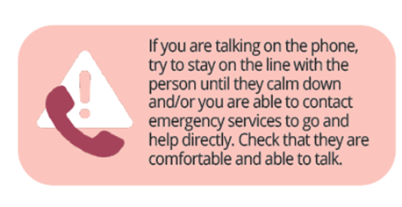
When Someone is Seriously Distressed
Notes:
Facilitator instructions:
– Talk through the steps of what to do if someone is seriously distressed.
– Point the group towards the guide for further information, and to Psychological First Aid (PFA).
This may bring up questions for some participants. Leave some time to answer questions.

Slide 40
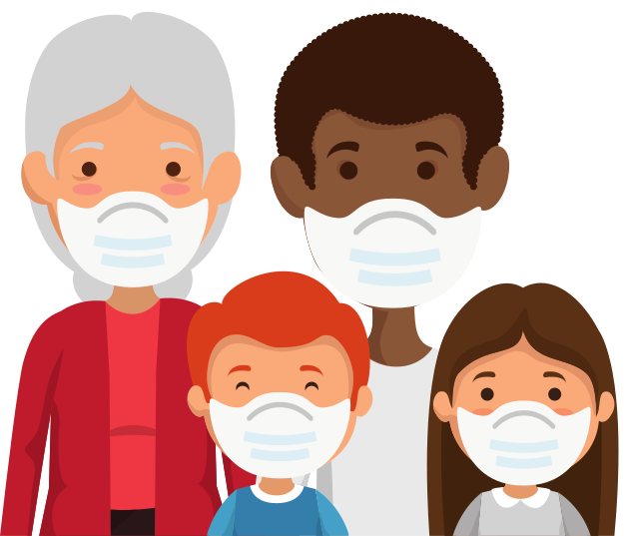

Module 5
Can you think of groups in your community who may require additional attention or support during the Covid19 Pandemic?
Notes:
Facilitator instructions:
– Summarise the training so far: so now we have finished looking at how to support others in everyday interactions, through practical and emotional support.
– Now we are going to look at which people in your community may need additional attention during the COVID-19 pandemic.
– Write the answers in the chat.

Slide 41
Groups who may require additional support
  People who are experiencing stigma relating to Covid19 (individuals and families)
  People at risk of, or currently experiencing, violence or discrimination (e.g. people experiencing gender-based violence and/or intimate partner violence that may escalate during movement restrictions during the pandemic, LGBTQ+, minorities)
  Older adults, especially those who are forgetful (e.g. those with dementia)
  People in rural and remote locations
  People who are also experiencing impacts from major incidents and disasters (natural or man-made)
  Pregnant women and people with chronic health conditions who need regular access to services
  People with disabilities, including mental health conditions and psychosocial disabilities
  Children, adolescents and their caregivers
  Those in crowded living conditions (e.g. prisoners, older adults in nursing homes, people in psychiatric hospitals, inpatient units or other institutions) or those who are homeless
  People living alone who have difficulties leaving their home
  People who may have difficulty accessing services (e.g. migrants, or people far from communication or transport options).
Notes:
Facilitator instructions:
– Show this slide and link this to the answers provided in the chat. Remind participants that there are links to additional information for these groups in Module 5 of the guide.

Slide 42
Stigma- the psychosocial impact
Annie became unwell with a headache, fever and a scratchy throat on Wednesday, so went for a Covid19 test, and self-isolated at home while she waited for her result. In the days waiting for the test result, she found herself feeling lonely and disconnected from her friends and family, and worried about how they would treat her when they heard about her illness.
Annie’s family live in a neighboring village and have not seen Annie for more than 3 weeks, but when someone there heard about Annie’s test, their attitude changed towards the family. The family were told they were not welcome in the local market, and local children were told that the family is ‘dirty’.
On Friday Annie received a negative Covid19 result. She no longer had symptoms of sickness so returned to work. Her office manager said that Annie could not have the amount of hours that she used to, as other workers were uncomfortable with her being in the office.
Notes:
Facilitator instructions:
You could consider the following questions with the group:
– Annie followed local health advice about getting tested for Covid19, and also self-isolating while she waited for test results. What reasons could there be for Annie feeling disconnected and worried?
What could the reasons be for neighbouring village members behaving the way they did when they heard about Annie’s sickness?
What psychosocial skills could be used to assist in reducing stigma and support wellbeing for Annie and her family? (Education about Covid19- dispelling myths and mistruths, providing understanding, practical and emotional support, ensuring that Annie feels connected even though she is physically not able to see friends and family when isolating, listening to stress/distress etc)

Slide 43
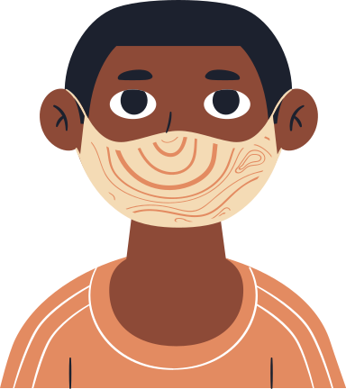
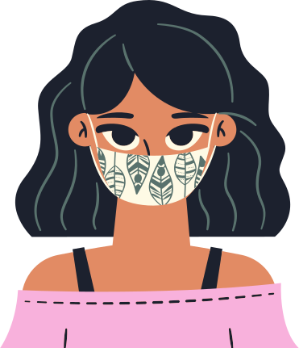

How are you most able to support others?
  Through everyday interactions
  Providing practical support
  Providing emotional support.
How can you best apply the basic psychosocial skills to your role?
Overall Reflection
Notes:
Facilitator instructions:
– Introduce the final reflection points, and ask participants to write their answers in the chat.
– Remind all participants about the Annexes in the guide and encourage them to do the daily schedule and the circles of control, and to have the information on services to hand. Also encourage them to read the guide, or parts of it, from time to time, as they find useful.

Slide 44

Please contact IASC MHPSS RG for translations and other resources.
https://interagencystandingcommittee.org/iasc-reference-group-mental-health-and-psychosocial-support-emergency-settings/iasc-guidance-basic
mhpss.refgroup@gmail.com
Thank you.
Notes:
Facilitator instructions:
– Ask the group if they have any questions.
– Thank them for their time.
-This resource was adapted for education within the Pacific region with the help of UTS WHO Collaborating Centre and the Basic Psychosocial Skills Pacific Working Group 2020.

