Slide 1
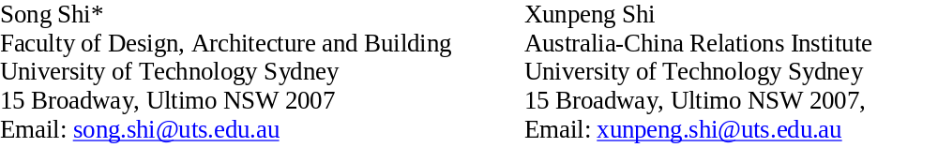
Has Chinese capital pushed up Australian house prices?
Song Shi* and Xunpeng Shi
(November 2021)

Slide 2
Chinese Buyers and Australian Housing Market
Chinese buyers are the fastest-growing segment of global property buyers.
  They spent US$100 billion on international residential and commercial properties in 2016, and were predicted to spend US$220 billion in 2020 (Juwai, 2017)
Chinese buyers are being blamed for pushing up local housing prices in Australia. However, that claim contradicts to the fact:
  Only about 2% of NSW home buyers PAID the foreign buyer surcharge in 2016.
  The current border restrictions have reduced foreign buyers' overall market share from the pre-pandemic 7-13% to 4% in new property markets (Gradwell, 2017; Wakelin, 2021).
  Among all foreign buyers, Chinese accounted for about 30% of them (Gradwell, 2017).

Slide 3
The Challenge In Foreign Investment Studies
Distinguishing local from foreign buyers in the market.
A recent survey found that more than 80% of Australians blame Chinese investors for rising house prices, even after a year of closed borders, when data showed that foreign property investment fell to record lows (Zhou, 2021).
The majority of Chinese buyers in the Australian housing market (resales market) were indeed local (domestic-Chinese or permanent residents) rather than foreign Chinese citizens.

Slide 4
Motivation Of This Research
Rather than distinguishing buyers, we studied this issue through the lens of capital flight by Chinese who rely on their savings in China to purchase real estate overseas.
  Australia is a migration country. Like many other migrant countries, migrants in Australia congregate in metropolitan areas such as Sydney and Melbourne and form their ethnic communities in urban settlements.
  These migrant communities maintain close connections to their home countries and play a key role in bringing business, international students and capital into Australia.
  There has been massive capital flight from China to other countries each year.

Slide 5
Chinese Capital Flight Is Through Various Channels.
Wong (2017) found that Chinese households made their real estate purchases abroad through travel (tourism or education).
According to Juwai, education is the chief motivation behind Chinese people purchasing real estate abroad (Juwai, 2015); they buy their children a place when they are studying overseas. Other factors include immigration, retirement, a holiday home or investment.
Chinese migrants overseas can get access through their savings in China and spend it overseas using AliPay, WeChat or UnionPay.
For the large sums of money required for real estate purchases, they may pool their relatives’ or friends’ credit cards or request family members to transfer the money to their overseas account.
Sometimes Australian-Chinese use underground banks to deal with foreign exchange or hold properties on behalf of foreign citizens.

Slide 6
Limitation On Currency Transactions (LCT)
On 30 December 2016, the People's Bank of China (PBOC) published "Administrative Measures on Reporting for Large-Value Transactions and Suspicious Transactions in Financial Institutions" (The People's Bank of China, 2016).
  The order took effect on 1 July 2017
  Banks enhanced their procedures to validate and authenticate personal foreign currency conversion transactions and monitor compliance by requesting individuals to complete detailed questionnaires.
  The foreign currency conversion quota was capped at US$50,000 per annum, and purchasing foreign property or investment in securities was explicitly prohibited.

Slide 7
We Find:
Using propensity score matching and difference-in-difference techniques, we found that the limitation on currency transition (Order No.3) issued by the People’s Bank of China (PBOC) in 2016 had a profound price impact (-2%) on the Sydney housing market, particularly in Chinese neighbourhoods (-4.5%).
We therefore present empirical evidence that Chinese capital is closely linked to the Australian housing market.

Slide 8
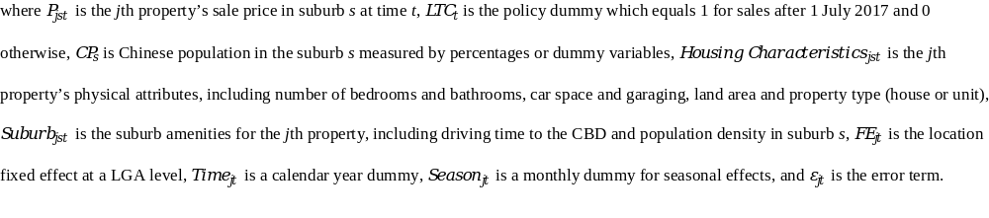
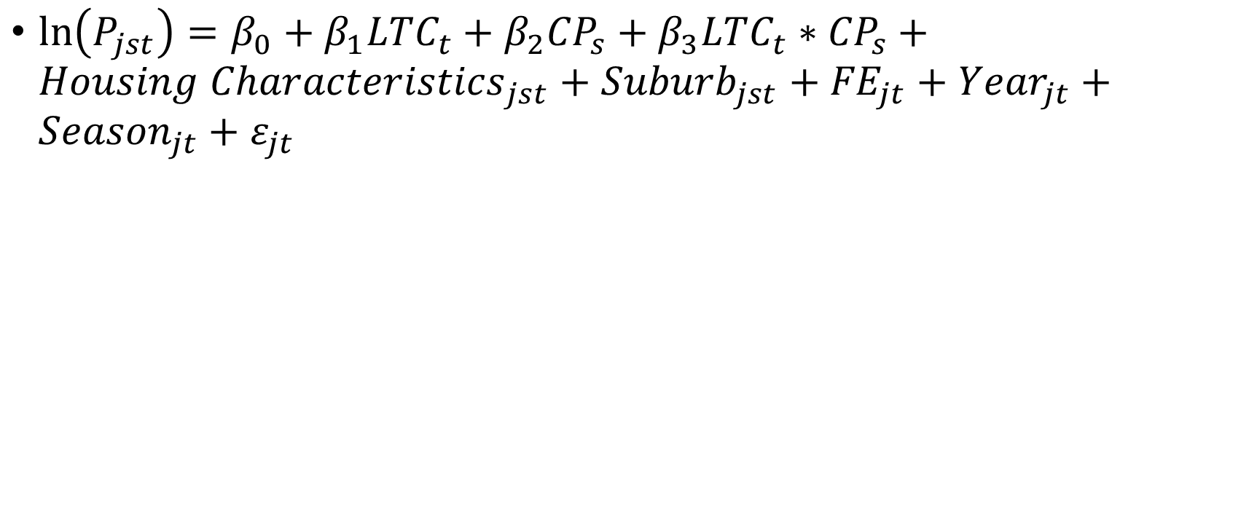
Empirical Analysis
$\ln\left(P_{jst}\right)=β_{0}+β_{1}{LTC}_{t}+β_{2}{CP}_{s}+β_{3}{LTC}_{t}∗{CP}_{s}+{Housing Characteristics}_{jst}+{Suburb}_{jst}+{FE}_{jt}+{Year}_{jt}+{Season}_{jt}+ε_{jt}$

Slide 9
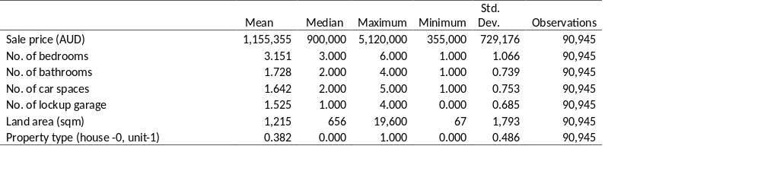
Residential Sales in the Sydney Metropolitan Area, 2016-2018
Residential property sale data was provided by the Rozetta Institute (formerly the Securities Industry Research Centre of Asia-Pacific (SIRCA)) on behalf of CoreLogic.

Slide 10
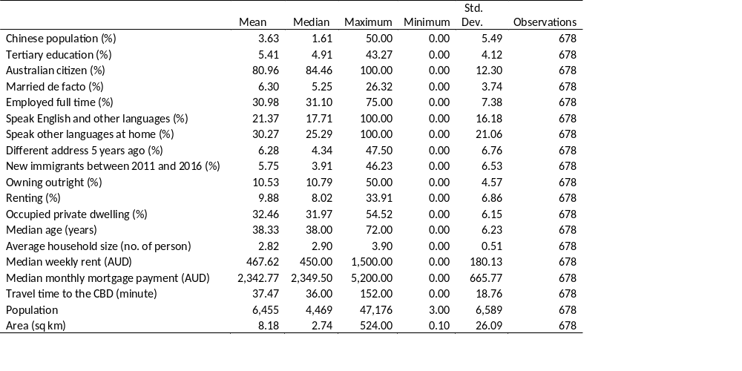
Suburbs In The Sydney Metropolitan Area
The suburb population profile data was obtained from the Australian Bureau of Statistics (ABS) 2016 census.

Slide 11
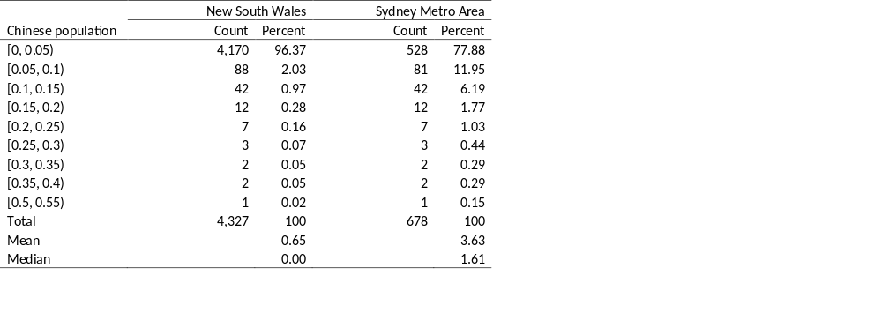
Distributions Of Chinese Suburbs

Slide 12
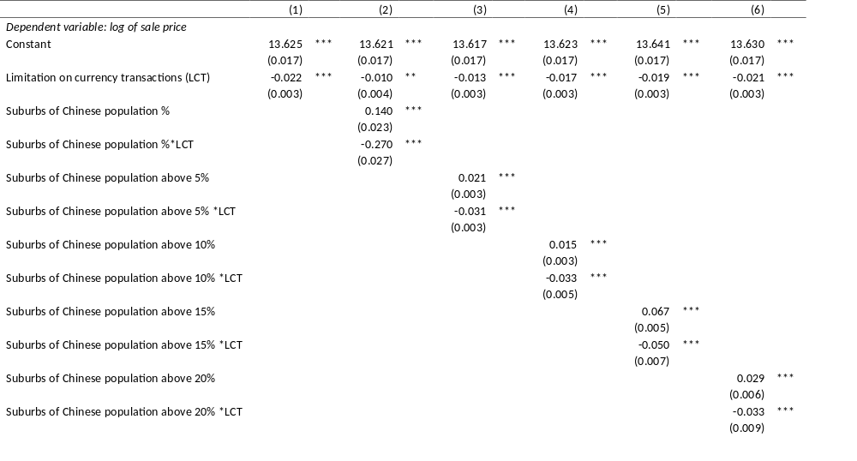
OLS Regressions Of China’s LCT On The Sydney Housing Market

Slide 13
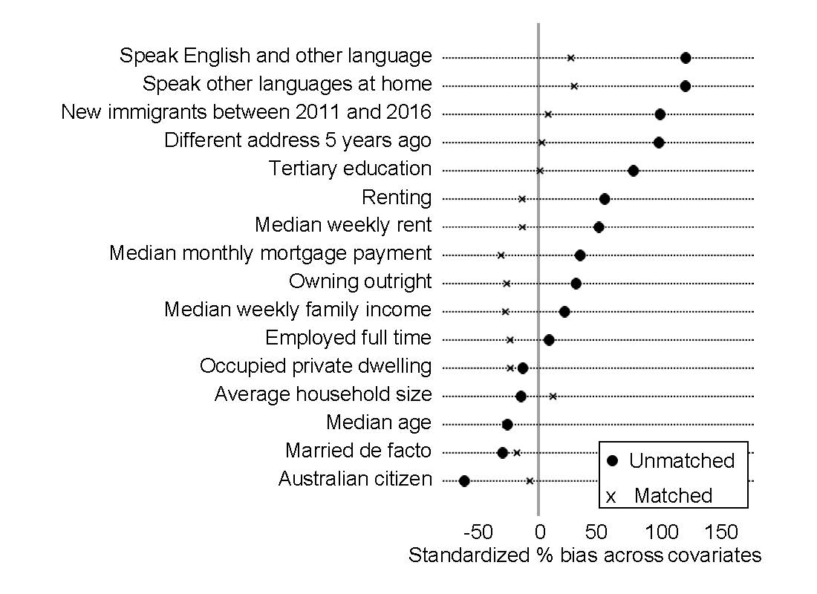
Chinese Suburbs Based On The PSM
In total, there are 580 matched suburbs left in this study
We followed the four steps below in the PSM testing:
Choose the covariates that predict a suburb is a Chinese or non-Chinese suburb.
Employ a logistic model to investigate the impact of these covariates on Chinese location choices.
Conduct a nearest neighbour search.
Conduct the analysis using the matched sample.

Slide 14
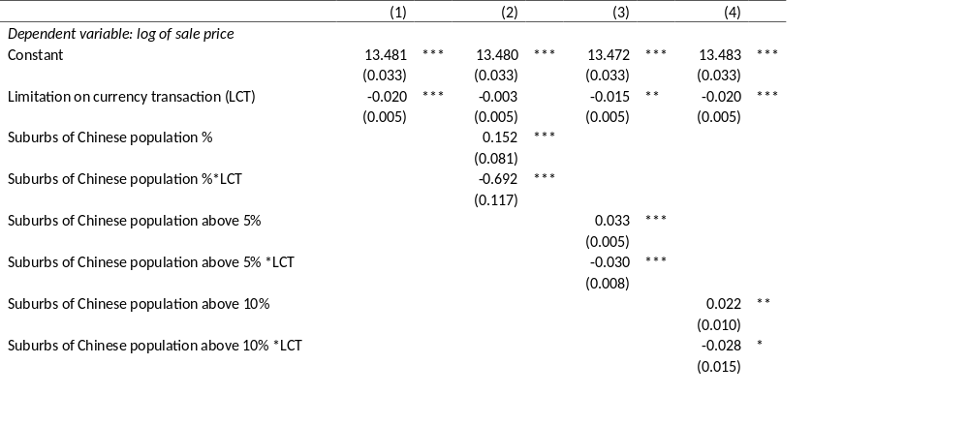
OLS Results Based On The Propensity Score Matching (PSM)

Slide 15
Robustness Checks
Regressions with Placebo treatments
  NSW non-Chinese Suburbs
  Randomly assigning Chinese suburbs
Regressions of top Chinese suburbs with a market consensus
  The most Chinese residents from 2020 Sydney Suburb Reviews
  Report from real estate agents on the most popular suburbs for Chinese buyers in 2018
Group the Sydney metropolitan area into five main regions based on the Greater Sydney Region Plan to account for the different time trends.
Restricting the sample by distance to the CBD.
We did not carry out a yearly pre-treatment trend testing as our testing period was short (one year before and after the policy shock).

Slide 16
Conclusions
Our results shows that Chinese capital was closely linked to the Australian housing market.
As foreign investment is restricted to new housing purchases in Australia, our results from the resale market suggested that domestic Chinese buyers were playing an important role in the Australian housing market.
Evidence from a real estate executive also showed that the buyers were dual citizens or permanent residents who conducted business in Australia and contributed to the country (Hall, 2020).
Lastly, it is perfectly normal that Chinese migrants maintain a close economic relationship with China and use their Chinese savings to purchase real estate overseas for meeting their living or investment requirements abroad. The phenomenon is not just for Australia but has also been seen in other migrant countries.

