Slide 1
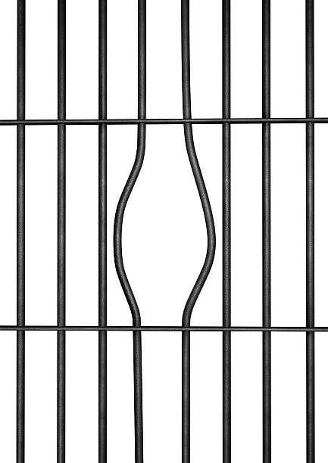
Colonial-carceralism & Family violence
Prepared by Thalia Anthony, Faculty of Law, UTS. Research conducted with Larissa Behrendt, Gemma Sentence and the amazing Aboriginal women we yarned with in NSW prisons
I honour the Larrakia people who are the sovereign people of this land.
Notes:
My presentation is unlike Harry’s and Vicki’s because it involved Aboriginal women in prison and although family violence was not the focus on the research per se – which was directed towards criminal sentencing - it did come up including because it was often the mechanism for the incarceration of First Nations women. Aboriginal women were caught in the penal system when men were being investigated or because they had themselves breached an AVO, which I will discuss.
My paper is on the role of penal responses to family violence in harming First Nations women and children.
I want to emphasise that the Aboriginal women did not necessarily have Aboriginal partners. This is one of problems with racialised criticisms of family violence – that it is exclusively Aboriginal men against Aboriginal women. However, in NSW it is also many non-Aboriginal men who are harming Aboriginal women and using their position in patriarchal white sovereignty – to use the phrase of Aileen Moreton Robinson – to subordinate Aboriginal women. This does not necessarily affect any of the findings, but just to caution researchers against relying on the colonial tropes about Aboriginal violence and overlooking white violence on Aboriginal women.
This presentation explores the findings of yarning circles and interviews with over 160 First Nations women in NSW prisons. Gemma Sentance, Michelle Toy, Larissa Behrendt and myself deploy a storytelling method to listen to First Nations mothers, grandmothers, aunties and sisters; voices that are marginalised by the legal system. The women shared stories revealing their strengths as carers and cultural teachers. They conveyed the harms of prison for their children and families. The findings demonstrate the need to decarcerate and empower First Nations mothers in order to negate colonial-carceralism.

Slide 2
COLONIAL CARCERALISM
Aileen Moreton-Robinson: ‘White Australia has come to “know” the Indigenous woman from the colonial gaze” in which “Indigenous women are objects who lack agency”
First Nations women objectified as victims and, increasingly, as offenders (Juanita Sherwood).
Notes:
Goenpul woman Professor Moreton-Robinson A explains how “White Australia has come to ‘know’ the ‘Indigenous woman’” from the colonial gaze in which “Indigenous women are objects who lack agency”. Moreton-Robinson regards the ‘possessive logic of patriarchal white sovereignty’ as objectifying Indigenous women. (Moreton-Robinson A (2000) Talkin’ Up To the White Woman: Indigenous Women and Feminism. Brisbane, QLD: University of Queensland Press.)
Harry Blagg wrote in 2008 how Aboriginal women for a long time did not fit into the coloniser’s victim trope, and when they did it was an ideal white victim – who was passive and to be saved by the carceral system
Wiradjuri Professor Juanita Sherwood discuss how stereotypes have extended to Aboriginal women as dangerous and offenders in contemporary society.

Slide 3
COLONIAL PATRIARCHY IN PENALITY: INCARCERATION OF FIRST NATIONS & NON-FIRST NATIONS WOMEN, PER 100,000
Notes:
Aileen Moreton-Robinson describes ‘patriarchal white sovereignty’ as the basis for the imposed law and law enforcement.
The colonial patriarchy enables the denial of self-determination and land sovereignty, and for Indigenous women’s lives to be treated without consequence, including in the criminal system.
Patriarchal colonialism in Australia has its genesis on violent frontiers, which penetrated Indigenous land for over a century. Australia’s Colonial Massacre Map depicts their devastation well into the twentieth century. Legislative enforcement of the settler colonial regime occurred under the Aboriginal Protection Acts. Between the nineteenth and mid-twentieth centuries, protectionist legislation assured the control and incarceration of Indigenous women on mission stations, settlements, homesteads and orphanages in pursuit of civilisation, assimilation and land occupation. The Aboriginal Protection Acts across Australia, like in Canada, assigned a “Protector of Aborigines” (a white male, often a police officer, pastoralist or missionary) to control Indigenous peoples’ employment, money, marriages, rations and movement. Under the Protection Acts, Indigenous women were subject to strict routines, including domestic labour that was often overseen by white women, and expectations of sexual servitude to white masters. Despite bringing up white children, Indigenous women were denied their roles as mothers and had their own children “stolen” by the state.
Institutionalisation and incarceration is currently justified with reference to the risk that Indigenous women pose, precipitating penal and child protection interventions. Incarceration rates have climbed exponentially for Indigenous women and girls since the twentieth century. Indigenous women are the fastest growing prison demographic, with rates increasing by 59% between 2000 and 2009 and doubling between 2009 and 2019. Indigenous women comprise over one-third (37%) of the female prison population (yet 1.29% of the general adult female population) and are 21 times more likely to be imprisoned. The attached Graph 1 illustrates this growth, and our research below humanises these statistics.
Most Indigenous women in prisons have committed minor offences. Indigenous women are predominantly sentenced for traffic offences (e.g. driving unlicensed), comprising over a quarter of offences. The next most common offences are disorderly conduct, common assault (without harm) and breach of a bail or supervision order. Indigenous women are described as “cycling in and out of prison”, with most serving short prison terms. At the same time, Indigenous mothers suffer from disproportionate state interventions in their family life. Indigenous parents, often single mothers, are 10 times more likely than non-Indigenous parents to have their children placed on care and protection orders or in out-of-home care – which is similar to Canadian rates. It adds new layers of trauma that continue to be experienced by surviving members of the Stolen Generations, including almost 20,000 Indigenous women. It also feeds into the criminal justice system, with 70.5% Indigenous girls in youth detention having also been in the child protection system.
While Indigenous women are targeted by the criminal justice system as offenders, Indigenous women victims have long been neglected by this system that fails to carefully investigate and prosecute the murders and deaths of Indigenous women. The carelessness is particularly acute for Indigenous women who die in police or prison custody, which is currently at a rate of more than 20 times that of non-Indigenous women in Australia. Law enforcers have become more diligent in investigating Indigenous male offenders suspected of violence against Indigenous women, especially where it allows the assertion of punitive control over Indigenous communities. This is supported by a model of “carceral feminism” – a mainstream movement that identifies the need to punish Indigenous men for Indigenous women’s victimisation, although often with the effect of capturing Indigenous women in the penal net. The justice system is less diligent when violence involves non-Indigenous males and non-Indigenous institutions.

Slide 4
What does carceral colonialism have to do with family violence?
Notes:
When I ask this question I’m not asking about social solidarity in the way in which Emile Durkheim or David Garland may ask this question.
Instead, I’m seeking to critically engage with carceral responses to family violence. In doing so, I will be drawing on the perspectives of First Nations women in prison.
These perspectives demonstrate that carceral responses to family violence have an overwhelming burden on First Nations women. Namely, family violence laws operate to incarcerate first First Nations and children and place stress on First Nations families. They are ineffective in ending the violence altogether.
I want to first discuss the ways in which we came to these findings with Larissa Behrendt, Gemma Sentence and Michelle Toy, including how we designed our research project.

Slide 5
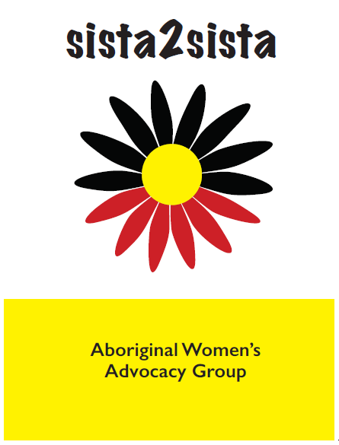
Building research ground-up and de-centering institutions
Mudgin-gal
Waminda
NSW Aboriginal Legal Service
Wirringa Baiya
SWOP
Grandmothers Against Removals
Deadly Connections
Notes:
This presentation explores the findings of yarning circles and interviews with over 162 First Nations women across eight NSW prisons, which we visited at least twice in 2019.
The research was conducted with First Nations scholars and activists Larissa Behrendt, Gemma Sentence and Michelle Today, and with the leadership of sista2sista – a local First Nations women’s group set up in Sydney to support this research.
Aunty Bronwyn Penrith has been especially powerful in this group.
We established the research advisory group called sista2sista to lead the research design and provide support for First Nations women in prison. These women came from a range of organisations and services shown on the slide and some also had lived prison experience. When women were released from prison we encouraged them to join sista2sista or call on us for support and solidarity.
We approached the research with a storytelling and yarning methodology. Women could share their stories without judgement either as a group, with a researcher or on paper. The women inside often chose all three. We also had surveys that asked about the women’s background, their experience with the criminal justice system and what could be changed. Overwhelmingly, First Nations women wanted to talk about how it had affected their roles as mothers and carers.
Family violence was often raised in terms of it triggering the criminal justice system’s involvement in their lives, or adverse consequences for their children because of the involvement of child welfare authorities.

Slide 6
Stories of First Nations women in prison
“I’m afraid of breaking an AVO because we have got kids together.”
Notes:
The women said that cross AVOs are “really common” (quote) and they get imprisoned for breaching orders.
Women spoke about how they had AVO orders imposed on them when there was a reported domestic dispute. They lived in fear that they would be picked up by police for breaching the order because they lived or interacted with their partner due to children. For some women, they were in prison due to police deeming them in breach of AVOs.

Slide 7
Hyper-surveillance of First Nations women due to AVOs
“[The police officer] knocks at the door on any day of the week at any time because there’s an AVO”

Slide 8
Carceral experiences
“We’re not being treated like mothers. We are strong independent black women and we deserve our rights, you know?”
Notes:
This quote is by a mother who said that she had also experienced family violence, but nonetheless prioritised her child’s wellbeing in her life.
She explains that the system fails to see her as anything more than a criminal since she has been caught up in its carceral network.
Mothers conveyed most prolifically in yarns the intergenerational trauma of being separated from their children – usually for minor matters – and that this can lead to permanent removal of children by welfare authorities.

Slide 9
Depriving children of their First Nations mothers
“By taking our children away from us. Putting us behind [bars], they don’t care about them. No one wants their kids more than their own family…”

Slide 10
Aboriginal women not considered “ideal victims” in their own sentencing
“I have been through domestic violence while pregnant with the father of my kids and in and out of refuges to be stable with my kids and have done counselling about it, but got told [by the judge] it wasn’t traumatising enough.”
Notes:
While family violence may be at the front and centre of the court hearing when the male is the perpetrator, especially the Aboriginal male.
However, when the female is an offender but also had experiences of family violence, her story is not heard by the court. This is articulated in this quote.

Slide 11
Implications of white carceral feminist approaches to family violence
Coercive control parliamentary debates and most research in 2021/2 sidelines First Nations women except as ideal victims
Chelsea Watego: Coerceive control offences ‘would result in more Indigenous women being imprisoned than protected’.
Ashleigh Donohue: ‘Aboriginal women are not believed when there standing in front of police busted up and dripping in blood. How the hell they going to be believed re: coercive control?’
Notes:
In the NT the victim is emphasised in sentencing when her story is congruent with tough prison sentences. Yet when this victim asks for Aboriginal-led responses – including that the perpetrator be exiled or undertake ceremony – such Aboriginal victims are ignored or belittled. Statements by Aboriginal victims that have said they want Aboriginal law rather than prison to be considered have been treated this way by the NT Supreme Court, including the cases of Queen v Turner in 2011, Queen and Bara in 2006 and Queen and Webb in 2003.
Chelsea Watego points out that in “Queensland, nearly 50% of Indigenous women murdered in domestic violence contexts have previously been named by the state as perpetrators.:”
This has also been the approach to family violence in the NT. NT Supreme Court judges make statements about family violence in Aboriginal communities and diminish claims that the justice system is racist, including by Arrente woman who oversees the development of the NT Aboriginal Justice Agreement, Leanne Liddle. These are the same judges who are responsible for incarcerating unprecedented numbers of Aboriginal adults and children. The same judges who failed to find that the gassing of Don Dale was unlawful because they preferred the approach of corrections.

Slide 12
Family violence and child protection interventions
Child welfare authorities take children when police intervene in family violence.
Similarly with reports to child welfare: “My DOCS worker told me, if I work with her and be honest with her, she will help me. But she used that against me [to take my kids]”
Notes:
Munanjahli and South Sea Islander professor Chelsea Watego also identifies how debates around family violence fail “to understand how the state itself perpetrates abuse and coercive control over Indigenous women.”
Through the lens of the First Nations mothers in prison, their removal from their children is a form of family violence.
Child protection authorities are also alerted when police become involved in family violence. Family violence is identified as a risk factor for children’s welfare authorities and grounds for removing children, irrespective of the care shown by the First Nations mother.
The women spoke about their children having been taken away due to incidents of family violence on the part of the father that they had disclosed to welfare authorities.
Allegations of family violence are major contributions to child removals from Aboriginal mothers in the NT as well, which the Royal Commission heard.

Slide 13
Carceral impacts of AVOs on First Nations children in care
“AVOs that are ostensibly a measure to protect vulnerable people are used by foster carers against Aboriginal girls who disobey them. So the AVO will specify that the child cannot conduct themselves in certain ways.”
(NSW Aboriginal legal service)
Notes:
One of the ALS offices we spoke to was that breach of these AVOs by Aboriginal girls was one of the most common reasons for their criminalisation and incarceration

Slide 14

Conclusion: from colonial carceralism to First Nations women’s sovereignty
Storywork: my stories are my spirit
Self-determination: the system needs to listen to us so we can tell our solutions

Slide 15
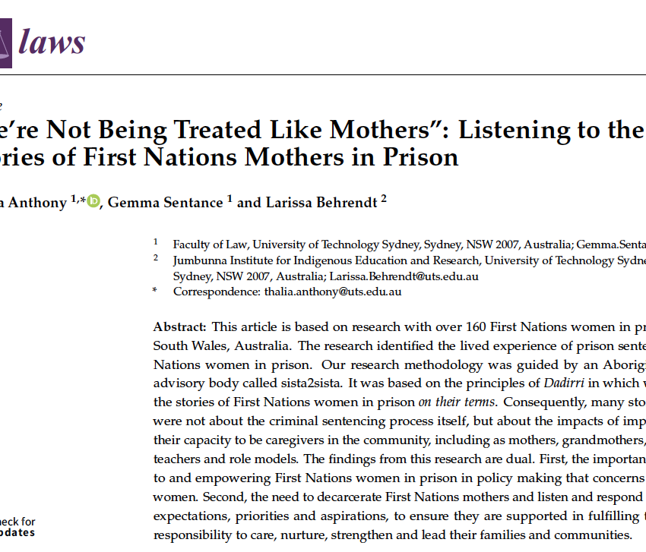
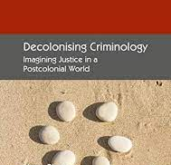
References
Thalia Anthony, Gemma Sentance & Larissa Behrendt (2021) “We’re Not Being Treated Like Mothers”: Listening to the Stories of First Nations Mothers in Prison, 10(3) Laws, 1-18.
Harry Blagg and Thalia Anthony (2019) Decolonising Criminology (Palgrave), Chapter 9 on ‘Carceral Feminism: Saving Indigenous Women from Indigenous Men

