Slide 1
Justice reinvestment in Cherbourg, QLD

Slide 2
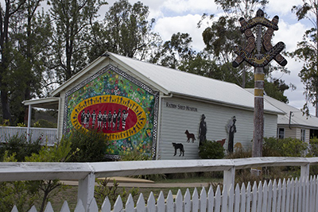
Cherbourg Justice Reinvestment Project
Ration Shed Museum, Cherbourg, QLD | Aims of early work of JR Community decision-making around support for and interest in implementing JR (inform community about JR, gather perspectives from community on way forward) Making a start on setting up or further developing key structures, partnerships and alliances to support collaborative effort, focused on community leadership Make a start on gathering material (such as data) to inform community decision making around JR and future implementation of JR, if community is on board In this and other ways, laying groundwork for Stages 1-4

Slide 3
Work undertaken to date
Steering Group with equal to majority community and justice system representation, as well as a DATSIP representative Supported a local Cherbourg champion, Gordon Wragge, to work with the community Started conversations with community: Key influencers (people without whom there would be no JR, including Cherbourg Aboriginal Shire Council) Those impacted by justice system (prisoners, young people who’d been in detention, their families) Young people (school students, Year 6 and upwards) Families facing difficulties Started gathering data (justice and non-justice data) Looked to what was happening with JR outside of Cherbourg

Slide 4
Conversations with community
Questions for Cherbourg Community What do you think about young people (10-25 years) from Cherbourg getting locked up? Why do you think young people in Cherbourg are getting locked up? What do you think we can do to help stop this happening? What would make Cherbourg an even better place to live, especially for young people? Do you think Justice Reinvestment would be a good thing for Cherbourg?

Slide 5
Importance of Community leadership
Community perspectives on community leadership | Letter from Cherbourg Aboriginal Shire Council supporting JR
Less bureaucracy input, more community and Elder input. Listen to us! We have the answers. They sit up there and make decisions for us when we could be doing it for ourselves. You work on any idea they want to do, whatever they’re willing to chase. It’s worth it because its theirs - meaning its ours (belongs to Cherbourg).... As small and as silly as our ideas might sound we need to invest in them…. Even if its one or two people to start with, we can take it from there. We can learn, we’ll encourage others. And it will be a natural flow. Once you get this up and running there might be a big change. The children can see somebody’s doing something for them. If we don’t start now this place is going to get out of hand. This is our future generation. JR is a good idea. Cherbourg could be the foundation for it, and other communities could say – oh Cherbourg is doing okay, can we join up on it?

Slide 6

Alignment with government policy
Recommendation 9 (status: in progress) The Review recommends that consideration should be given to the implementation of justice reinvestment collaborations between existing community-based services and YJ. (7.R7) A Youth Justice led project is underway. A consultant has been working with the Cherbourg community to assess suitability and readiness for justice reinvestment. Cherbourg Local Council has endorsed a final report by the consultant. As of September 2018, we are considering implementation options, project expansion and the governance required for a whole of government initiative.

