Slide 1
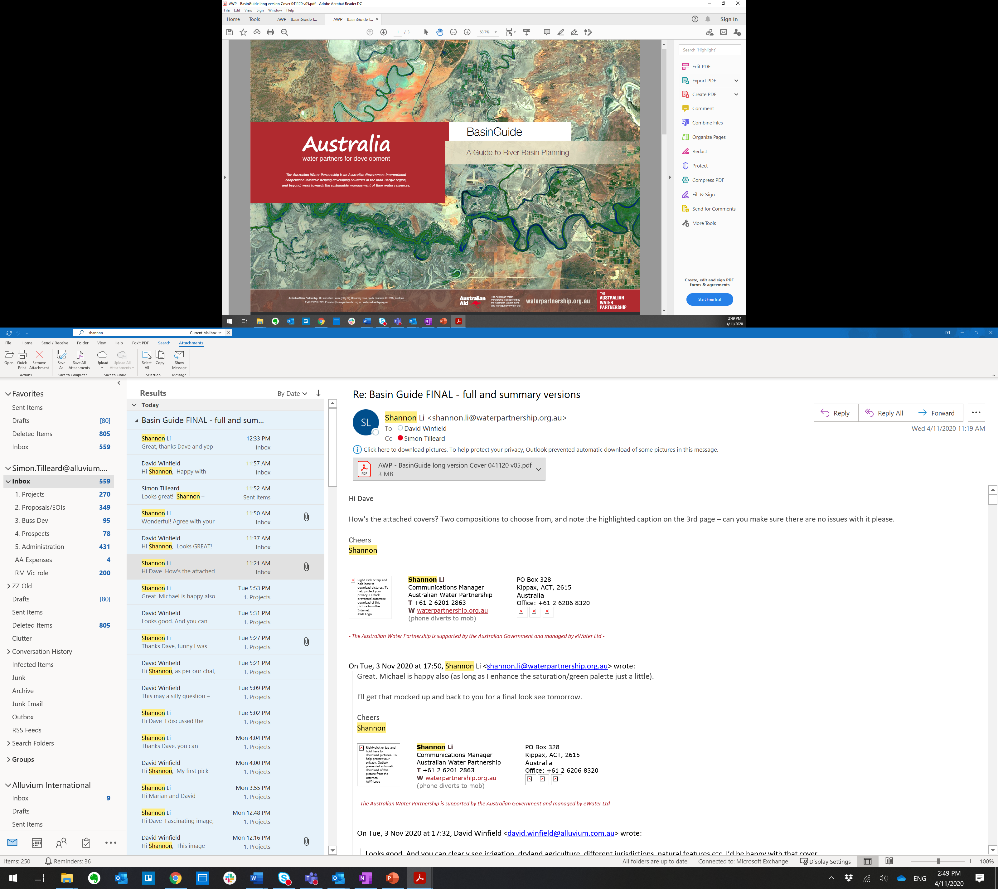

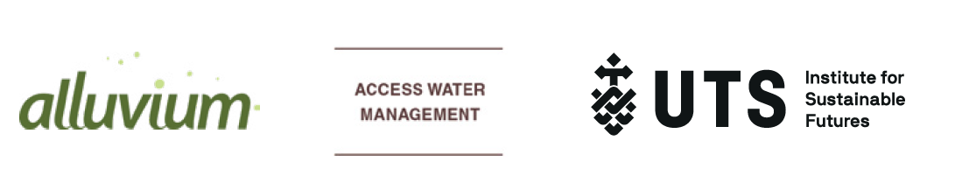

Slide 2
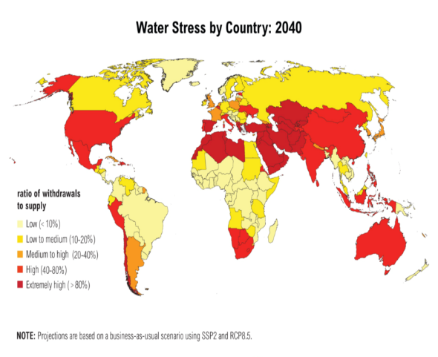
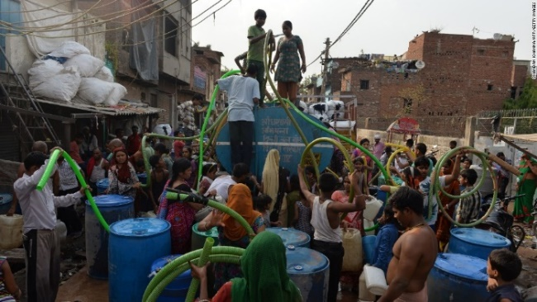
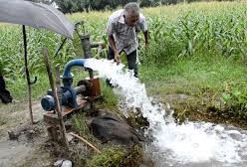
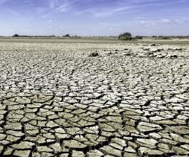
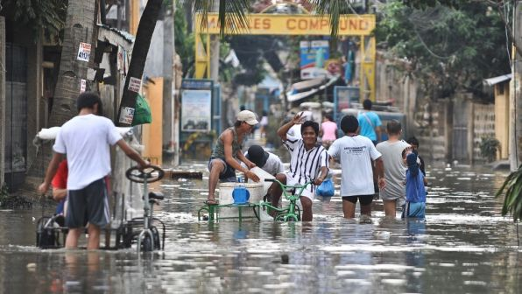
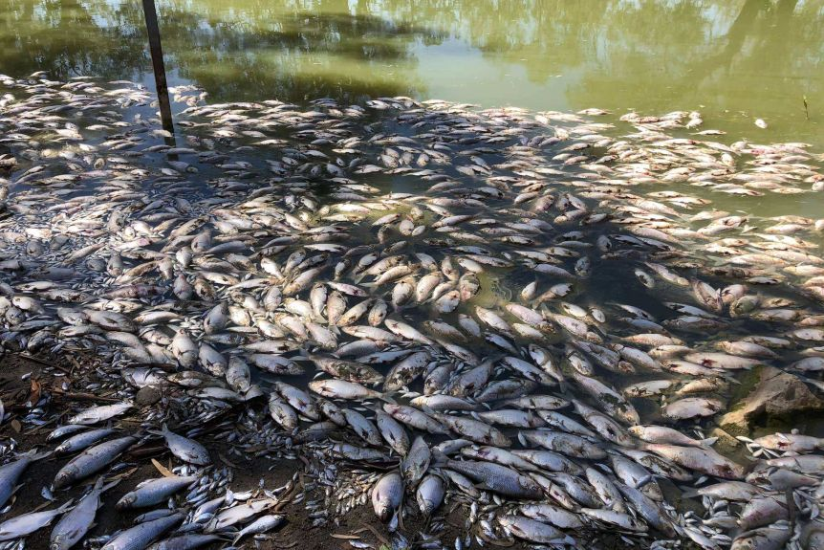

Drivers for River Basin Planning
Water is needed to sustain lives, livelihoods and the environment within a rapidly changing climate
Notes:
Over 2 billion people experience high water stress to be increased to almost 3 billion by 2030 (United Nations, 2018; GWI, 2013)
Indo-Pacific countries face increasingly complex challenge of sharing water to sustain lives, livelihoods and the environment within a rapidly changing climate
Water scarcity leads to disputes at local, national and international level
To address the challenges – countries have committed to addressing SDGs specifically SDG 6 (Ensure availability and sustainable management of water and sanitation for all)
Picture Source: https://www.weforum.org/agenda/2019/10/water-inequality-developing-world-usa-west/

Slide 3

River basin planning – a part of the solution
Basin planning is a way to facilitate different interests and water needs at a river basin scale.
It acknowledges the inherent connections between surface and groundwater, up and downstream, cities and farms.
Basin planning addresses:
People and political challenges
Hydrological and environmental challenges
Notes:
Basin planning is a way to facilitate different interests and water needs at a river basin scale.
It acknowledges the inherent connections between surface and groundwater, up and downstream, cities and farms. Basin planning is a way to facilitate different interests and water needs at a river basin scale. It ideally is a way to consider a whole system linked by waterways, in an integrated way.
Basin planning addresses:
People and political challenges by involving people in a collaborative way to examine water resources and negotiate options for sustainable use
Hydrological and environmental challenges in managing limited and contested water resources by establishing limits to extraction, water sharing mechanisms, plans and governance mechanisms

Slide 4
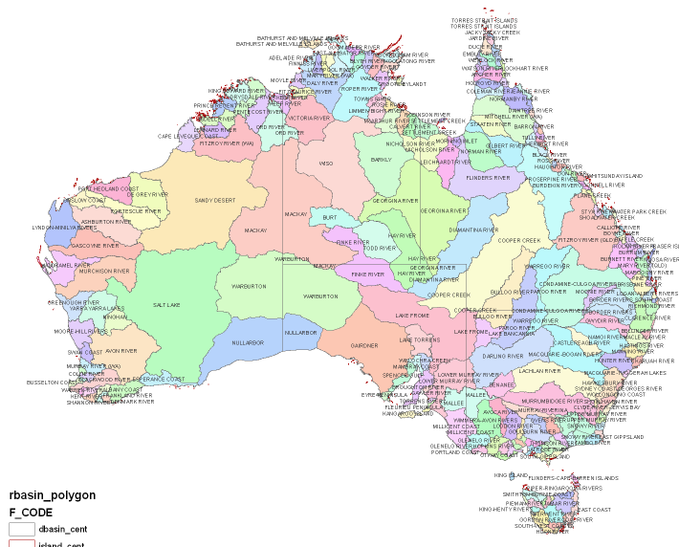
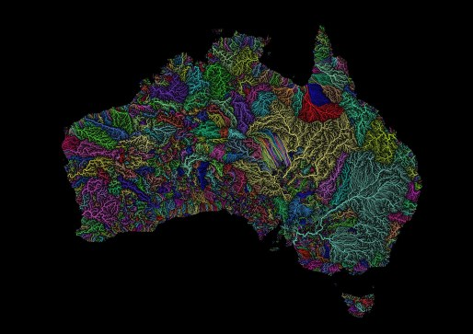
Australia’s experience in river basin planning
Since the Dreaming or time immemorial, Aboriginal and Torres Strait Islander Peoples have managed and occupied the land and waters of Australia, including the MDB region.
Australia continues its journey of dealing with increasing water demands in a highly variable and changing climate
Australia’s approach is underpinned by basin planning processes (Murray Darling and elsewhere in Australia)
Internationally, there is strong interest in the Australian basin planning experience

Slide 5
The Basin Guide - underpinned by Australian and international experiences in basin planning
Purpose
Reference for practitioners undertaking river basin planning in the Indo-pacific region
Scope
Surface water planning (although recognises importance of ground water-surface water interactions)
Audience
Can be used at a range of levels of government from designing to implementing policy and to support NGOs, community and stakeholder groups
Focus on sharing of water resources
By David Winfield, Melita Grant Tony Weber, Simon Tilleard and David Harriss
https://bit.ly/350w7IN

Slide 6
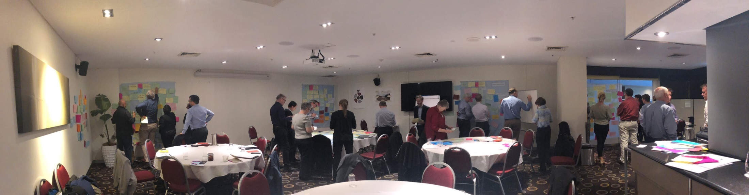
Process of BasinGuide development
Collaborative development process
Informed by work with Indian water planners
Experts workshop
Expert reviews
Engaged with representatives from
National and State government
Indigenous (First nations) people
Communities
Environmental advocates

Slide 7
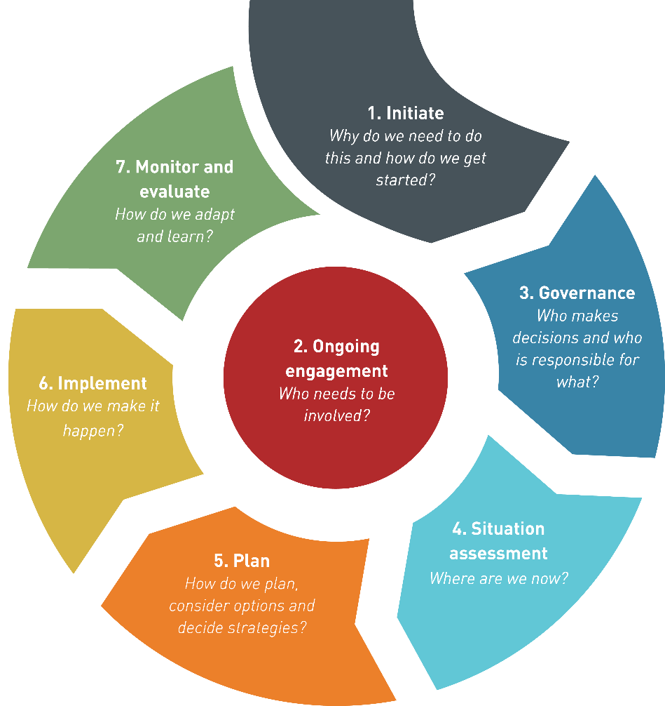
BasinGuide Stages

Slide 8
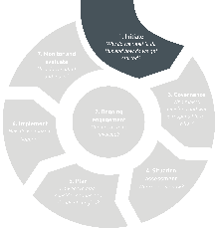
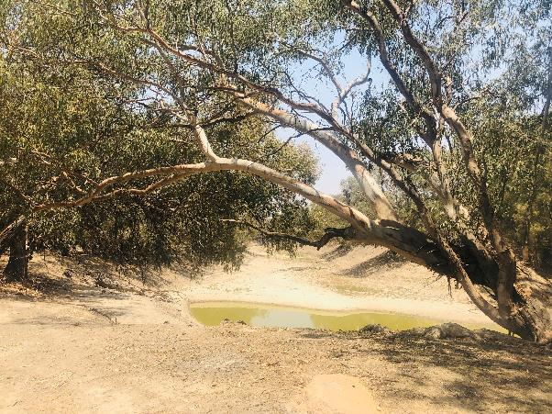
Stage 1: Initiate
Initiating and Visioning
Why do we need to do this and how do we get started?
Understand the why
Build a network of support and leadership
Be clear on scope
Develop a basin vision and objectives (with Indigenous peoples, community, stakeholders, industry..)

Slide 9
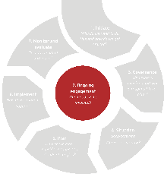
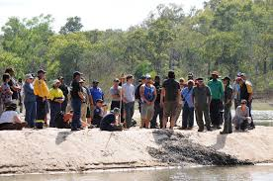
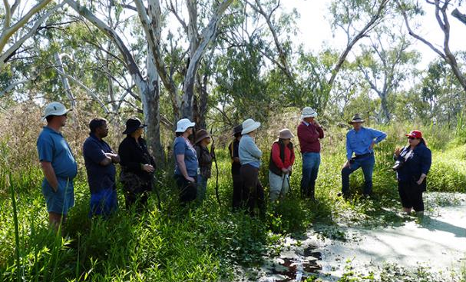
Stage 2: Ongoing Engagement
Engaging stakeholders and the community
Who needs to be involved ?
Map out all stakeholder groups and develop and implement a stakeholder engagement plan
Engage and draw on the knowledge of Indigenous Peoples, women, people with disabilities, minorities.
Share all of the available information
Seek political leadership and support
Transparently identify and assess the values and objectives of all stakeholders
Consider different forms of stakeholder engagement and governance

Slide 10
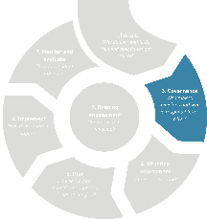
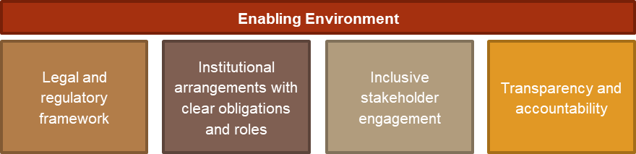
Stage 3: Governance
Enabling governance, policy and legislation
Who makes decision and who is responsible for that?
Consider a wide range of forms of stakeholder engagement and governance mechanisms
Notes:
Establish appropriate institutional arrangements
Support transparency, accountability and openness
Begin interjurisdictional dialogue and develop agreements on process & forum to discuss & address issues & decision-making (governance arrangements)
Empower River Basin Organisation (RBO)
Establish a dispute resolution process
Key Outcomes:
Enabling legislature established
Enabling policy and regulatory framework established
Institutions empowered to develop and implement basin plan
Clarity of roles and responsibilities of various stakeholders

Slide 11
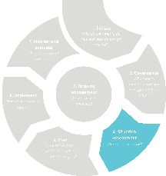
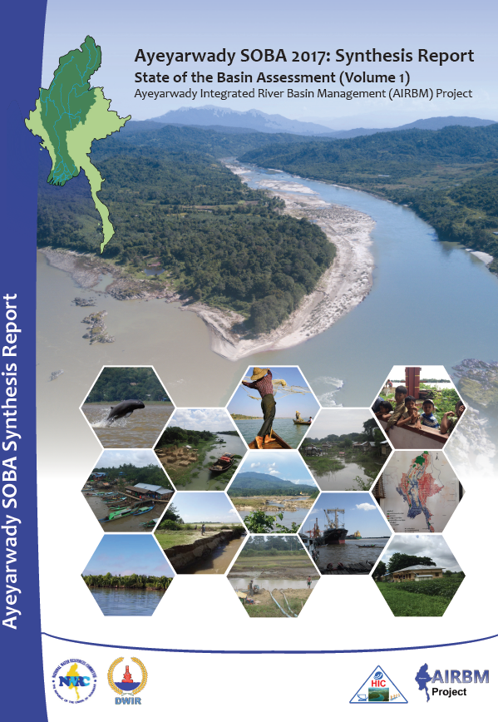
Stage 4: Situation Assessment
Assessing current status and trends for surface and ground water
Where are we now?
Undertake a situation assessment
Engage communities in building a common understanding of the basin
Identify issues of common concern
Utilise water resources modelling and data
Notes:
Situational analysis of
the available resources,
their characteristics and
risks to those resources
Key Outcomes:
Understanding of the basin’s situation documented in a state of the basin report
Process established to actively engage and involve all stakeholders
Present and future water supply and demand quantified
Issues of common concern identified

Slide 12
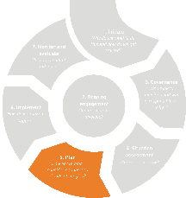
Stage 5: Plan
Identify strategy options
Evaluate strategy options against criteria, using information (data, modelling, scientific, local and traditional knowledge)
Negotiate trade-offs to decide on the strategies to be adopted
Integrate selected strategies into a basin plan
Identify responsibilities for implementation
Agree on support for those negatively impacted
Ongoing communication and engagement
Considering strategies, options, negotiating trade offs and making decisions
How do we plan, consider options and decide strategies?
Notes:
Key Outcomes:
Basin plan supported by a transparent decision making process and supporting information
Basin plan developed to achieve agreed basin objectives and vision
Agreement between stakeholders on options/strategies outlined
Mechanisms agreed to compensate negatively impacted stakeholders

Slide 13



Stage 5: Plan (b)
Establish system needs
Specify the flow regime needed to sustain the river and set a sustainable limit of extraction
Distribute extractive shares
Establish a basis for allocating the water assigned to extractive uses
Manage demand and supply
Outline how extractive water users will operate within their allocated shares of water
Operational strategies Climate change, scarcity and drought; Flood management planning; Groundwater management; Water quality and pollution control
Notes:
Key Outcomes:
Basin plan supported by a transparent decision making process and supporting information
Basin plan developed to achieve agreed basin objectives and vision
Agreement between stakeholders on options/strategies outlined
Mechanisms agreed to compensate negatively impacted stakeholders

Slide 14
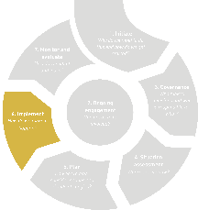
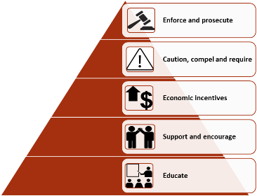
Stage 6: Implement
Implementation of water plans and ongoing management
How do we make it happen?
Resourcing, responsibilities and accountabilities for plan implementation
Regulation, compliance and enforcement
Community’s role in behavioural change and in tracking compliance
Adaptive management processes
Notes:
Key Outcomes:
Clear decision-making process and governance framework outlining roles and responsibilities
Ongoing engagement with community stakeholders
Ongoing community programs, regulation, compliance and enforcement to ensure the plan is implemented

Slide 15
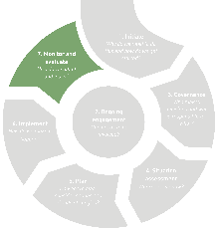
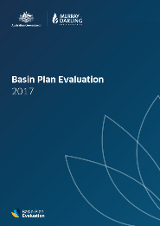
Stage 7: Monitor and evaluate
Monitoring, evaluation, reporting and adaptive management and learning
How do we adapt and learn?
Planning is a cycle
Accountability and transparency in implementation
Data sharing and information management arrangements
Evaluation, learning, review and remaking of the river basin plan
Notes:
Source: https://paragraphs.com/smart-objectives-b2b-social-media/

Slide 16
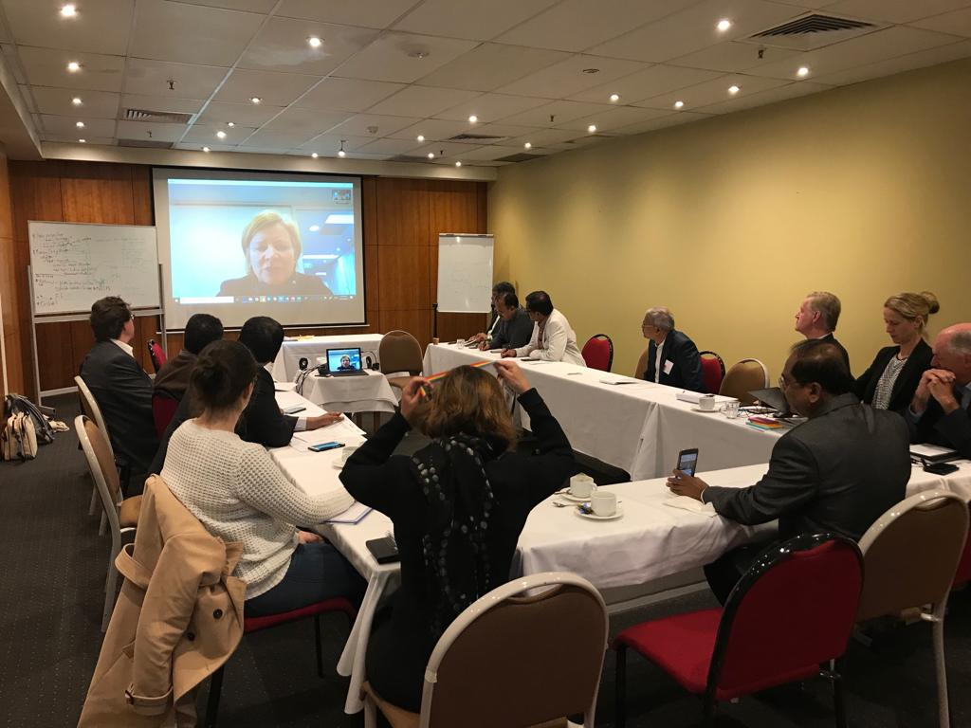
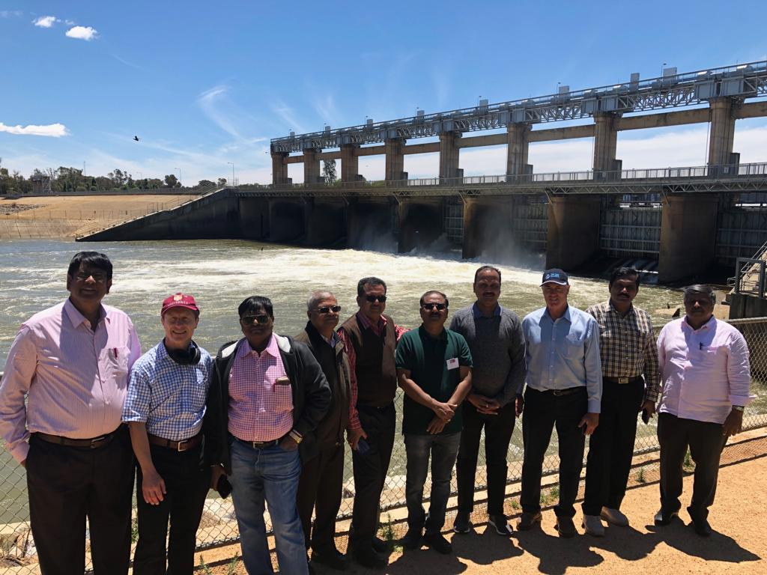
Application of the Basin Guide
Relevant at a range of scales
Consider the context
Identify key areas of need and entry points
Stages, guiding questions, key actions and outcomes
Australia has a range of skills and capabilities that can assist

Slide 17
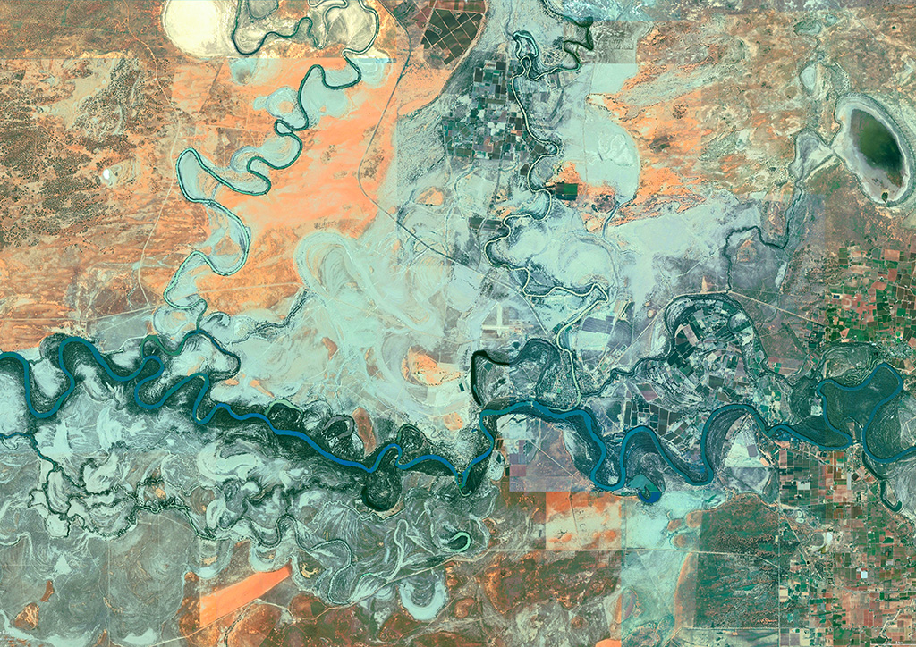
Any Questions?
BasinGuide can be downloaded from: https://bit.ly/350w7IN
Contacts for more information:
Rory Hunter, Australian Water Partnership: rory.hunter@waterpartnership.org.au
David Winfield, Alluvium: david.winfield@alluvium.com.au
Melita Grant: melita.grant@uts.edu.au
Notes:
Use product image

