Slide 1
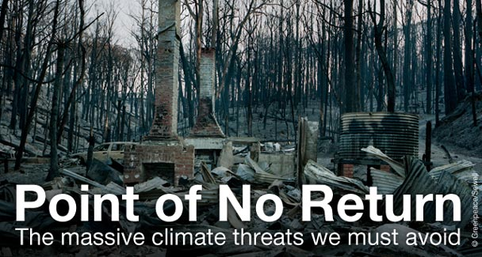
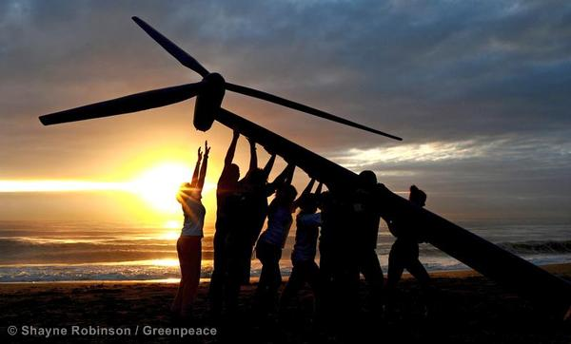
Inspiring transformation: The art of positive futures
“There are two wolves who are always fighting.
One is darkness and despair.
The question is…which wolf wins?
The one you feed”.
The other is light and hope
Notes:
I am going to very briefly report on a research project I am just starting that takes as its starting point the ongoing debate on the role of positive and negative visions of the future in facilitating transformation in the context of climate change. The debate was nicely captured in the recent Disney film Tomorrowland, which called for a more positive orientation towards the future as an antidote to the dystopian doom and gloom that characterises much popular media - what Susan Sontag called the ‘aesthetics of disaster’.
The film uses a reworking of a Cherokee parable to make its point. "There are two wolves who are always fighting. One is darkness and despair. The other is light and hope. The question is... which wolf wins?” The answer is: "The one you feed”. In this view, if we want transformation, perhaps we should be focusing on providing images of a positively transformed world rather than images of climate catastrophe.

Slide 2
Positive and negative imagery and climate change
Images of climate change impacts
Negative associations and emotions
Capture attention, but can create distance and undermine self-efficacy
Some negative emotions do arouse and engage
Images of solutions (e.g. solar panels)
Positive associations and emotions
Create feelings of self-efficacy, but might not arouse urgency
Criticised for “brightsiding” – avoiding the urgent realities
‘We lack a coherent positive narrative of climate change’ (Leviston et al. 2014) and many questions are unresolved
Notes:
Of course, the real world is not as simple as Hollywood would have us believe. The emerging scholarship on the role of visual communication and imagery in public engagement with climate change has drawn some tentative conclusions on the use of positive and negative imagery:
Negative, dystopian, doom and gloom imagery about the impacts of climate change can capture attention but also creates distance, undermining self-efficacy.
However, some negative emotions are arousing rather than distancing, and could lead to greater engagement.
Positive imagery of solutions (such as solar panels and wind turbines) creates feelings of self-efficacy (but may not sufficiently capture attention) - has been criticises for ‘bright siding’ - shying away from the reality of the problem.
As Leviston et al put it, ‘we lack a coherent positive narrative about climate change'
Much remains uncertain:
Can we blend attention-capturing imagery of climate change impacts with positive imagery of a transformed world in ways that increase public engagement?
How does interaction with visual imagery change social practices and behaviours?
What role does participation in the generation of positive future imagery play in level of engagement?

Slide 3
The research
Stages
Sampling imagery used by NGOs and artists to provoke engagement with climate change in Australia through websites and social media
Coding the types of futures depicted in this imagery
Workshops to explore engagement created by different types of imagery
Very tentative findings
‘Causes’ imagery (e.g. fossil fuels) is most prevalent, then ‘impacts’, then ‘solutions’
Variations across channels (social media shares more ‘positive’ images and infographics than websites) and NGOs (radical vs. reformist)
Artistic work is more ambiguous – often difficult to code due to abstract nature and diversity of possible interpretations
Notes:
Stages of the research:
Sampling imagery used by NGOs and artists to provoke engagement with climate change in Australia through websites and social media
Coding the types of futures depicted in this imagery
Workshops to explore engagement created by different types of imagery

