Slide 1






Decoding Disruptive Technology and Fostering an Innovation Culture
Professor Steve Burdon
The CEO Circle Melbourne Seminar
9 November 2016

Slide 2


1.0 Background
New era of disruptive technology began in 2013, forged by ubiquitous development software and AI.
New insights emerging from creative industries on how to foster an innovative culture.
1.

Slide 3
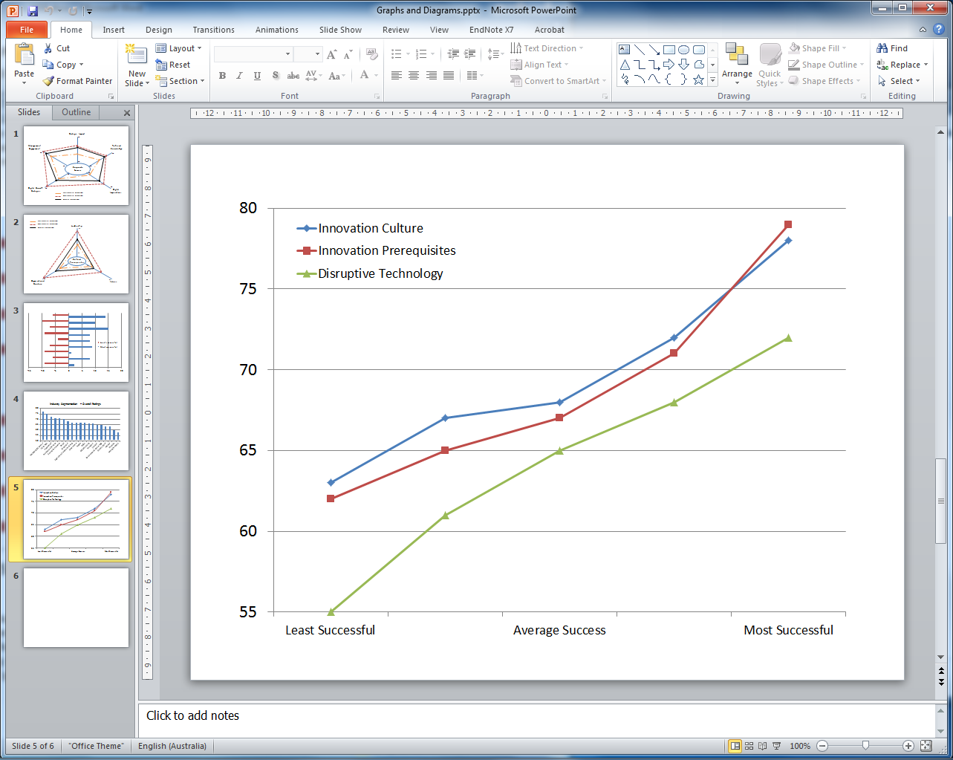
2.0 Overview
Relationship between Success and Harnessing Disruptive Technology & Fostering an Innovation Culture
2.

Slide 4
2.0 Overview
Urgency intensifying as more business models are disrupted.
Strong relationship between success and ability to harness disruptive technology and foster an innovation culture.
61% of respondent organisations had less than satisfactory results.
Senior leaders can learn from the palette of insights from best-in-class organisations.
3.

Slide 5
3.0 Disruptive Technology Results
Of the five issues examined, there were very large differences (44%) for the top two issues of digital imperatives and digital growth.
3.1 Digital Imperatives
Handling the six digital imperatives well was the largest differentiator for success, the top four being:
Thinks about digital innovation end-to-end – optimises value.
Frequently tests products with customers – strong customer focus.
Secures a place in a network of companies and customers – creates opportunities for mutual value.
Often rethinks its business model – major disruption risk.
4.

Slide 6

3.0 Disruptive Technology Results
3.2 Digital Growth Strategies
Successful companies will generate much more of their planned future growth from digital initiatives. For the three growth initiatives, the differences were very large and close to 50%. The ranking order was:
Building competitive advantage with existing businesses.
Creating new business.
Improving existing business.
5.

Slide 7


3.0 Disruptive Technology Results
3.3 Management & Board Engagement with Digital Strategies
Successful organisations achieve a higher level of engagement and support from their Boards and Management Teams.
CEOs of the least successful organisations gave much higher scores for their organisations than their Boards and C-levels.
On average respondents gave their NEDs a lower score for engagement and support than Management.
6.

Slide 8

4.0 Prerequisites for an Innovation Culture
Despite growing awareness of the important prerequisites, only successful organisations implement these well.
4.1 Leadership
The role of leadership for successful organisations is becoming critically important, even as the skills and requirements for success change.
‘my CEO demonstrates leadership’ was universally scored well, but there was a large difference in the question ‘my organisation has the necessary network of leaders’.
7.

Slide 9
4.0 Prerequisites for an Innovation Culture
4.2 Organisational Structure and Design
Only successful organisations have been able to implement a structure that encourages multiple collaborations, quick decision making and flexibility.
4.3 Corporate Values
Many leading organisations emphasised Management by Values (MBV), by humanising the attitudes and actions required to establish an innovative culture, rather than the historic higher emphasis on the importance of ethical and social values.
8.

Slide 10
5.0 Establishing an Innovation Culture
Implementing five of the ten issues studied was a major differentiator between the organisations - averaging 68%.
Being adaptable and easily embracing change.
Values doing, taking risks and experimenting over detailed and methodical planning.
Organisations are part of an interlinked community.
Actively encouraging and rewarding people who generate and drive ideas.
Build a network of innovation resources internally and externally.
9.

Slide 11

6.0 Additional Research Outcomes
More details on CEO Circle website including:
Why Brisbane has created an edge over Melbourne and Sydney.
Why medium-sized companies in the digital age have trouble being successful.
How you can compare your organisation’s performance with your industry.
10.

Slide 12

7.0 Summary
The research showed a very high correlation between success and the ability of organisations to deal with digital disruption and create an innovative culture.
We recommend that CEOs and Boards explore their own employees’ views and compare their progress with the successful organisations.
11.

